Slide 1
Brooklyn Day Hab

Slide 2
Working on Skills to Be Successful
Cooking- Hey We All Have To Eat :)
We are looking at microorganisms which are all around us.
Science
We have
made Latkes, pancakes and Quesadillas all with a hot plate and a pan.

Slide 3
We have Fun outside and Inside
Coney Island is a place to eat famous Nathan Hotdogs, go on carnival rides and enjoy the beach.
We Are Brooklyn
Sip & Paint
Exploring and using our imagination.

Slide 4
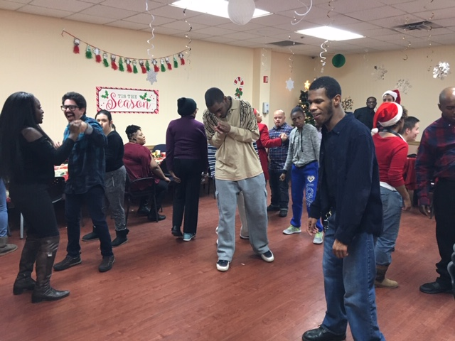
Music-
We can also make our own tunes with a keyboard and a computer.
Listening & Dancing to our favorite tunes.

Slide 5
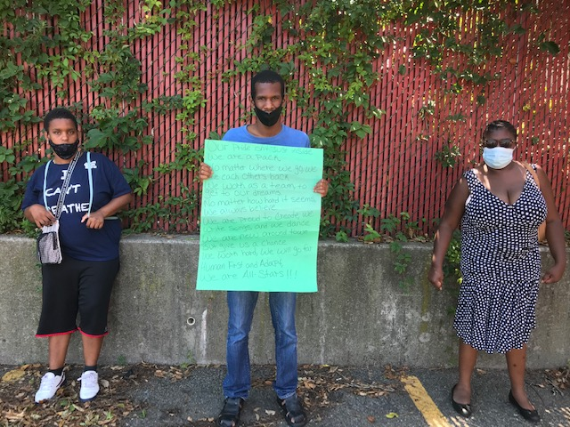
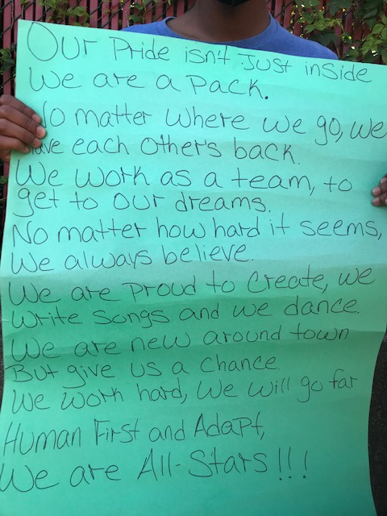
Self-Advocacy & Speaking Up
We Self-Advocate because We Can!!
"Nothing About Us Without Us"- James Charlton Disability Rights Movement

Slide 6
We Party Harty
We work hard to improve communication, social and academic skills but we got to have Fun :)

Slide 7
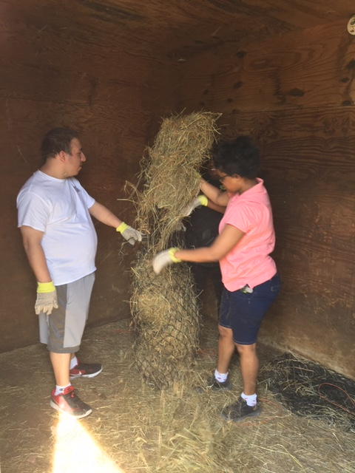
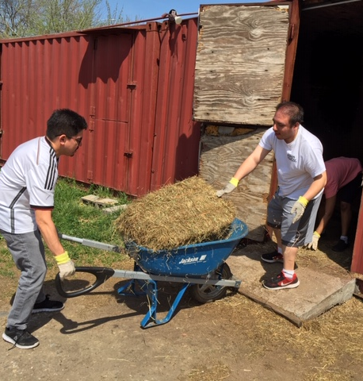
Volunteer Activities
Gallopnyc is an organization which supports all New Yorkers especially people with disabilities to increase their core muscles, communication and socialization skills through Equine Therapy sessions. Volunteers assist riders by walking besides them to help the rider to increase their confidence, also assist in grooming and feeding the horses.
GallopNYC

Slide 8
Contact Information: Director of Community Hab and Day Hab: Lasana Rayside : 646-761-1625 Coordinator of Day Services: Jason Schneider 516-519-1769

