Slide 1


NYC Day Habilitation Program
Providing Services & Support

Slide 2
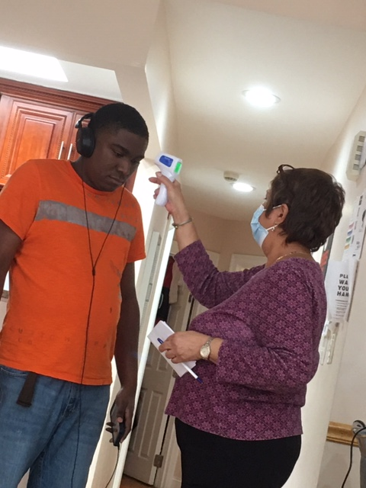
Safety First- Checking each person’s temperature staff and people being supported.

Slide 3
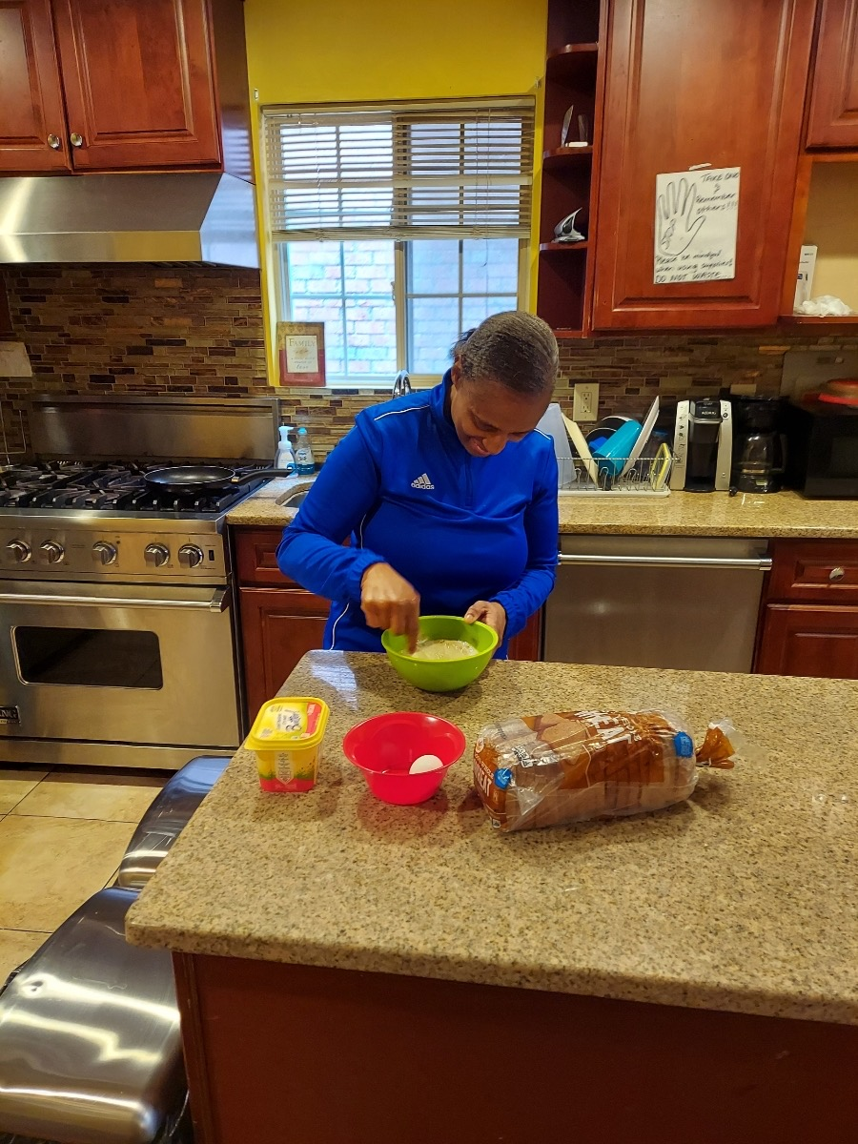
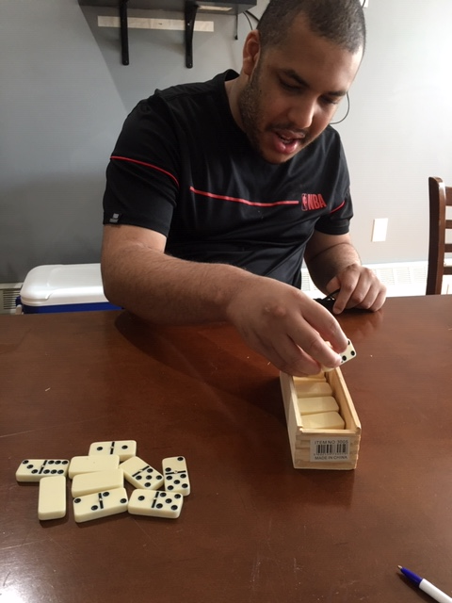
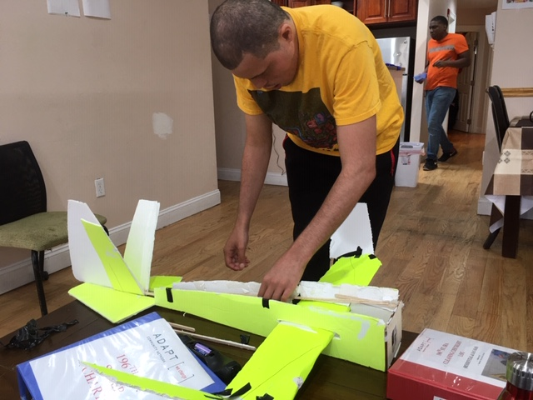
Learning new skills during Statewide Quarantine
Exploring new hobbies and learning important daily living skills such as cooking.

Slide 4
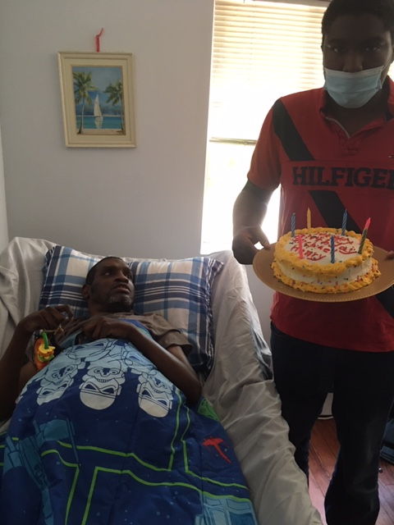
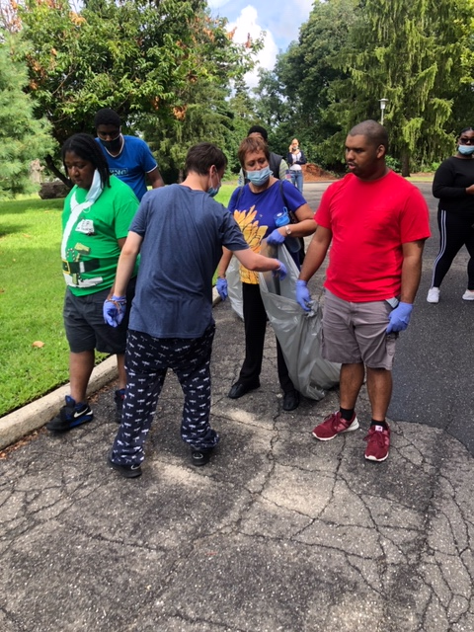
Helping Others As a Way of Feeling Better About Ourselves During a Challenging Time In History.
Birthday Parades= Make a cake and go house to house to brighten up someone’s special day.
Volunteer sites are a great way to build upon job skills and making a positive contribution to the community.

Slide 5
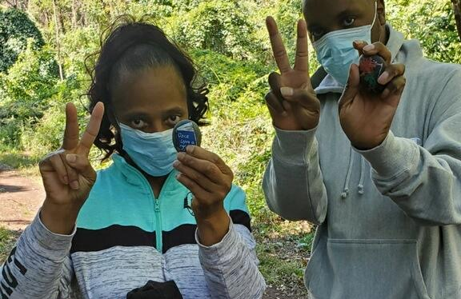
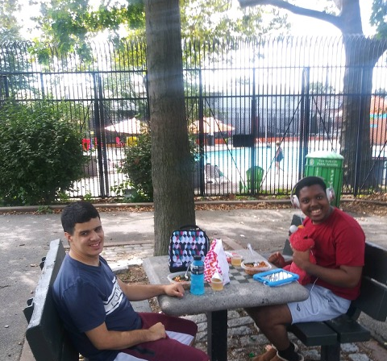
Venturing Out Into The Community
WE are going to open spaces such as our local parks where we can have fun and socialize in a safe manner.

Slide 6
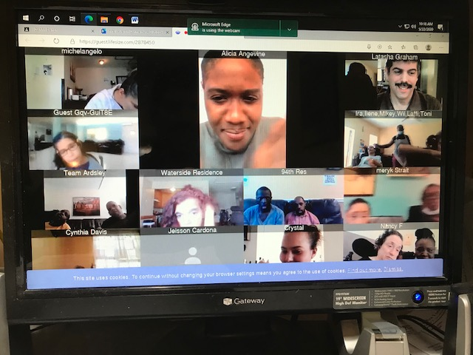
Reaching Out to Other's Outside of my Group of Peers
The ADAPT morning show is an awesome way to get to know other people from the safety and comfort of our own living rooms.

Slide 7
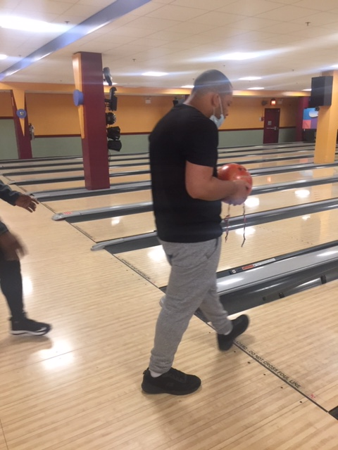
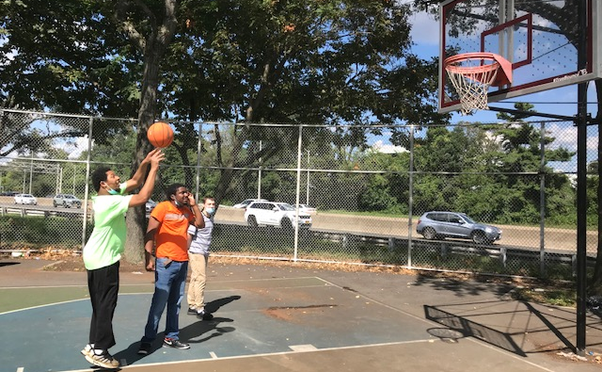
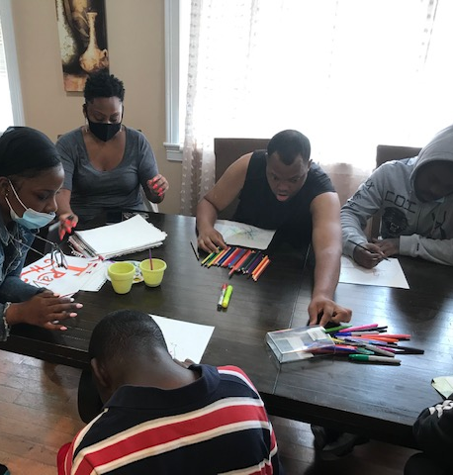
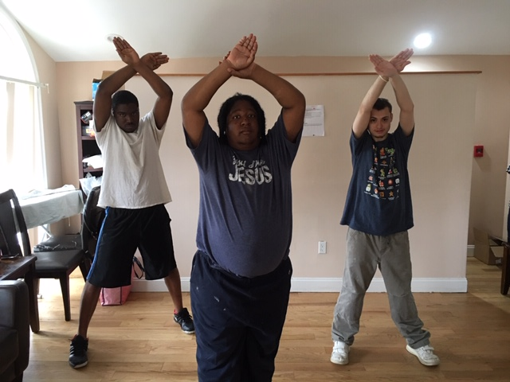
Socialization
While we are inside the house, we are learning new ways to express ourselves such as doing art, yoga and exercising. Outside we can go bowling and play games such as basketball.

Slide 8
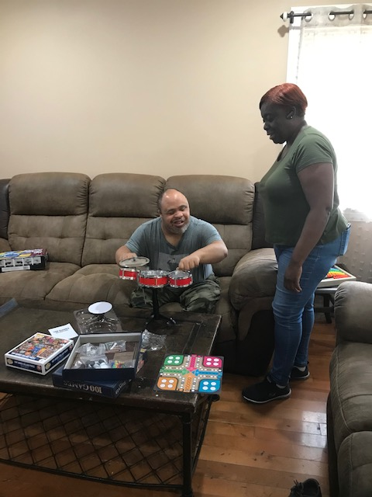
Self Expression- You can’t see by looking at the picture, but I am blind (lol- a little pun) however I love to play the drums!

Slide 9
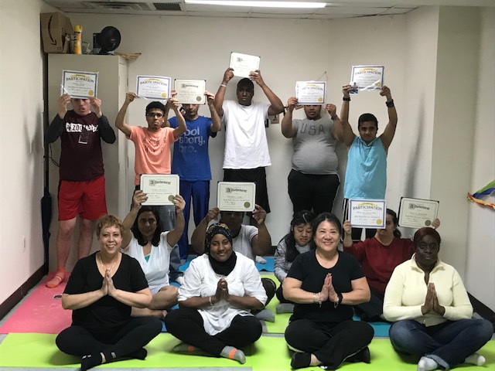
Contact Information for The NYC Day Habilitation Program:
Director of Community Hab and Day Hab Programs- Lasana Rayside 646-761-1625
Coordinator of Day Services for NYC Day Hab: Jason Schneider 516-519-1769
NYC Day Hab Program: We support people with Intellectual and Developmental disabilities who live both in a residential, group home setting ,as well as, with their families to expand upon existing skills, learn new skills in order to live independent, productive and meaningful lives.
We welcome new talents, new experiences and always the opportunity to make new friends.

