Slide 1
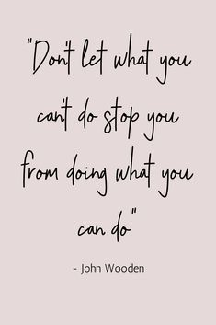
The Pride Center Farmingdale Day Habilitation
We’re in this together.
Human First STRONG.

Slide 2
What is the Pride Center?
The Pride Center is a multi-faceted service center that offers a safe and supportive environment focused on skill enhancement and learning.
This state-of-the-art facility provides comprehensive services for adults with special needs.
The Pride Center is distinguished from all other adult programming and features both customized and group activities. At the Pride Center, we foster self-concept, self-esteem, and independent growth.

Slide 3
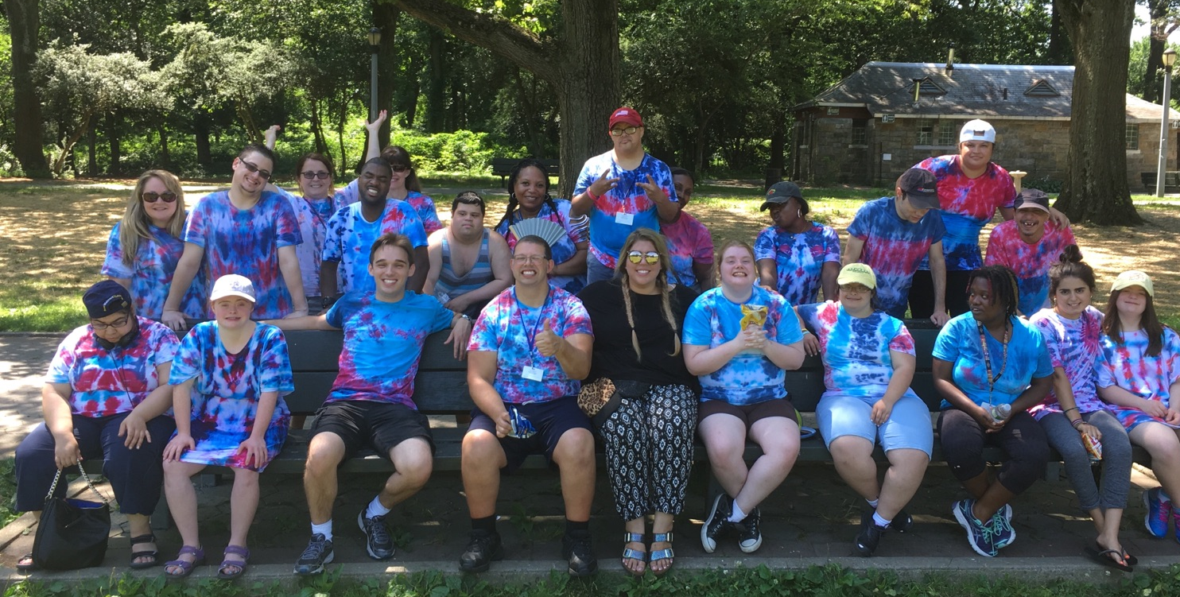
Farmingdale day hab family

Slide 4
The First Steps…
Upon Enrollment, a Day Habilitation Plan is written for each person supported after a 30-day period of assessment and feedback.
Profile of the Person – demographics, family & home life, interests & hobbies, etc.
Medical Alerts, Allergies, Medications, Dietary Needs
Behavioral Support Needs
Safeguards Provided by Staff
Valued Outcomes – Long-Term goals
Staff Supports & Services – Short-Term goals designed to reach the individual’s Valued Outcomes.

Slide 5
Valued Outcome Areas
Academic Skills
Money Management
Computer/Media
Recognition/Identification of bills and coins
Calculating costs and change
Purchasing items while in the community
Letter/Number Recognition
Word Recognition
Current events/news, history, geography, trivia
Addition, subtraction, division, multiplication
Typing – personal information, simple sentences, formatting letters
Internet- job search, current events, using as a search engine
Safety Skills
Health & Wellness
Socialization
Safety skills in the community
Becoming familiar with your surroundings
Practicing social distancing and avoiding large gatherings
Sports – YMCA
Exercise Classes – HopeFitness
In-house workouts – Yoga, Dance, and Fitness
Group discussions on nutrition, cooking healthy choices
Museums, tours, sightseeing
Movies
Bowling
Creative Arts
Local Events and Fairs
Work Readiness
Independent Living Skills
Professionalism
Interview Skills
Volunteer work in the community
Cooking
Housekeeping
Personal Care

Slide 6
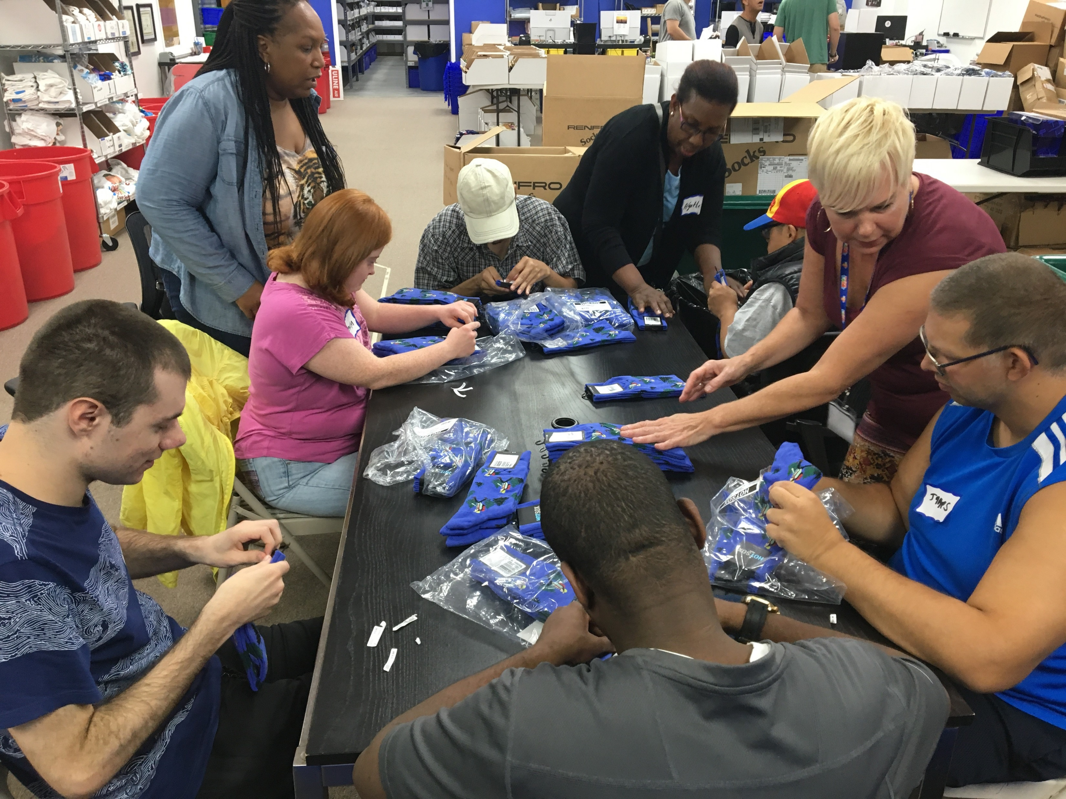
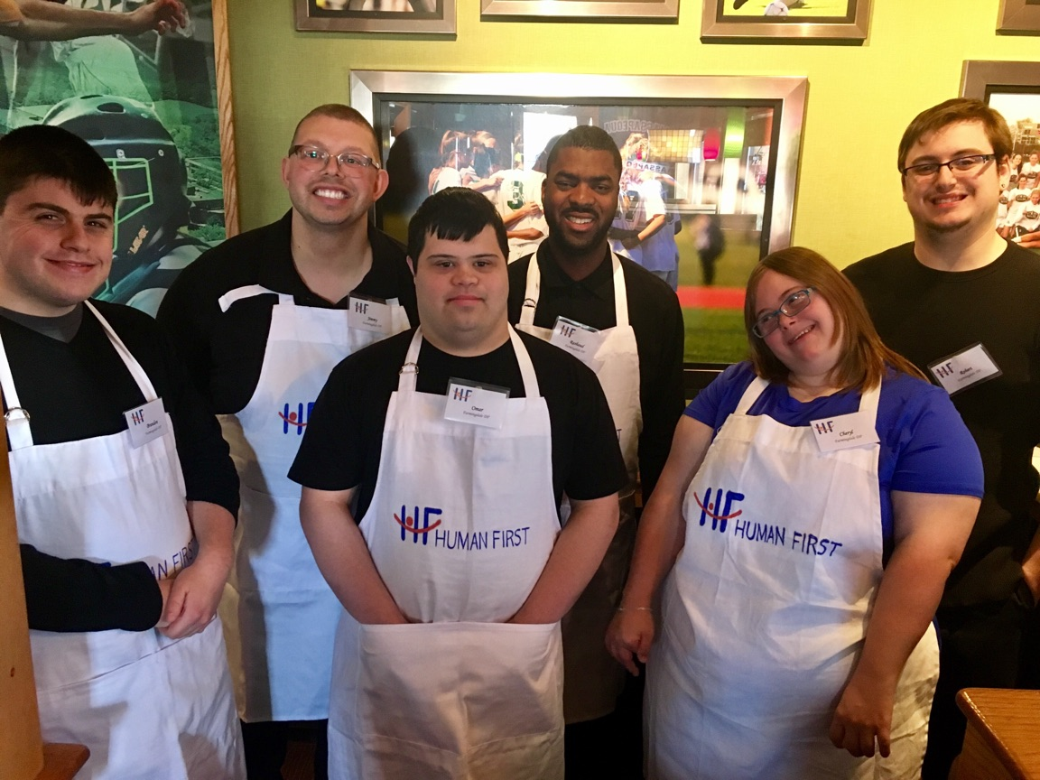
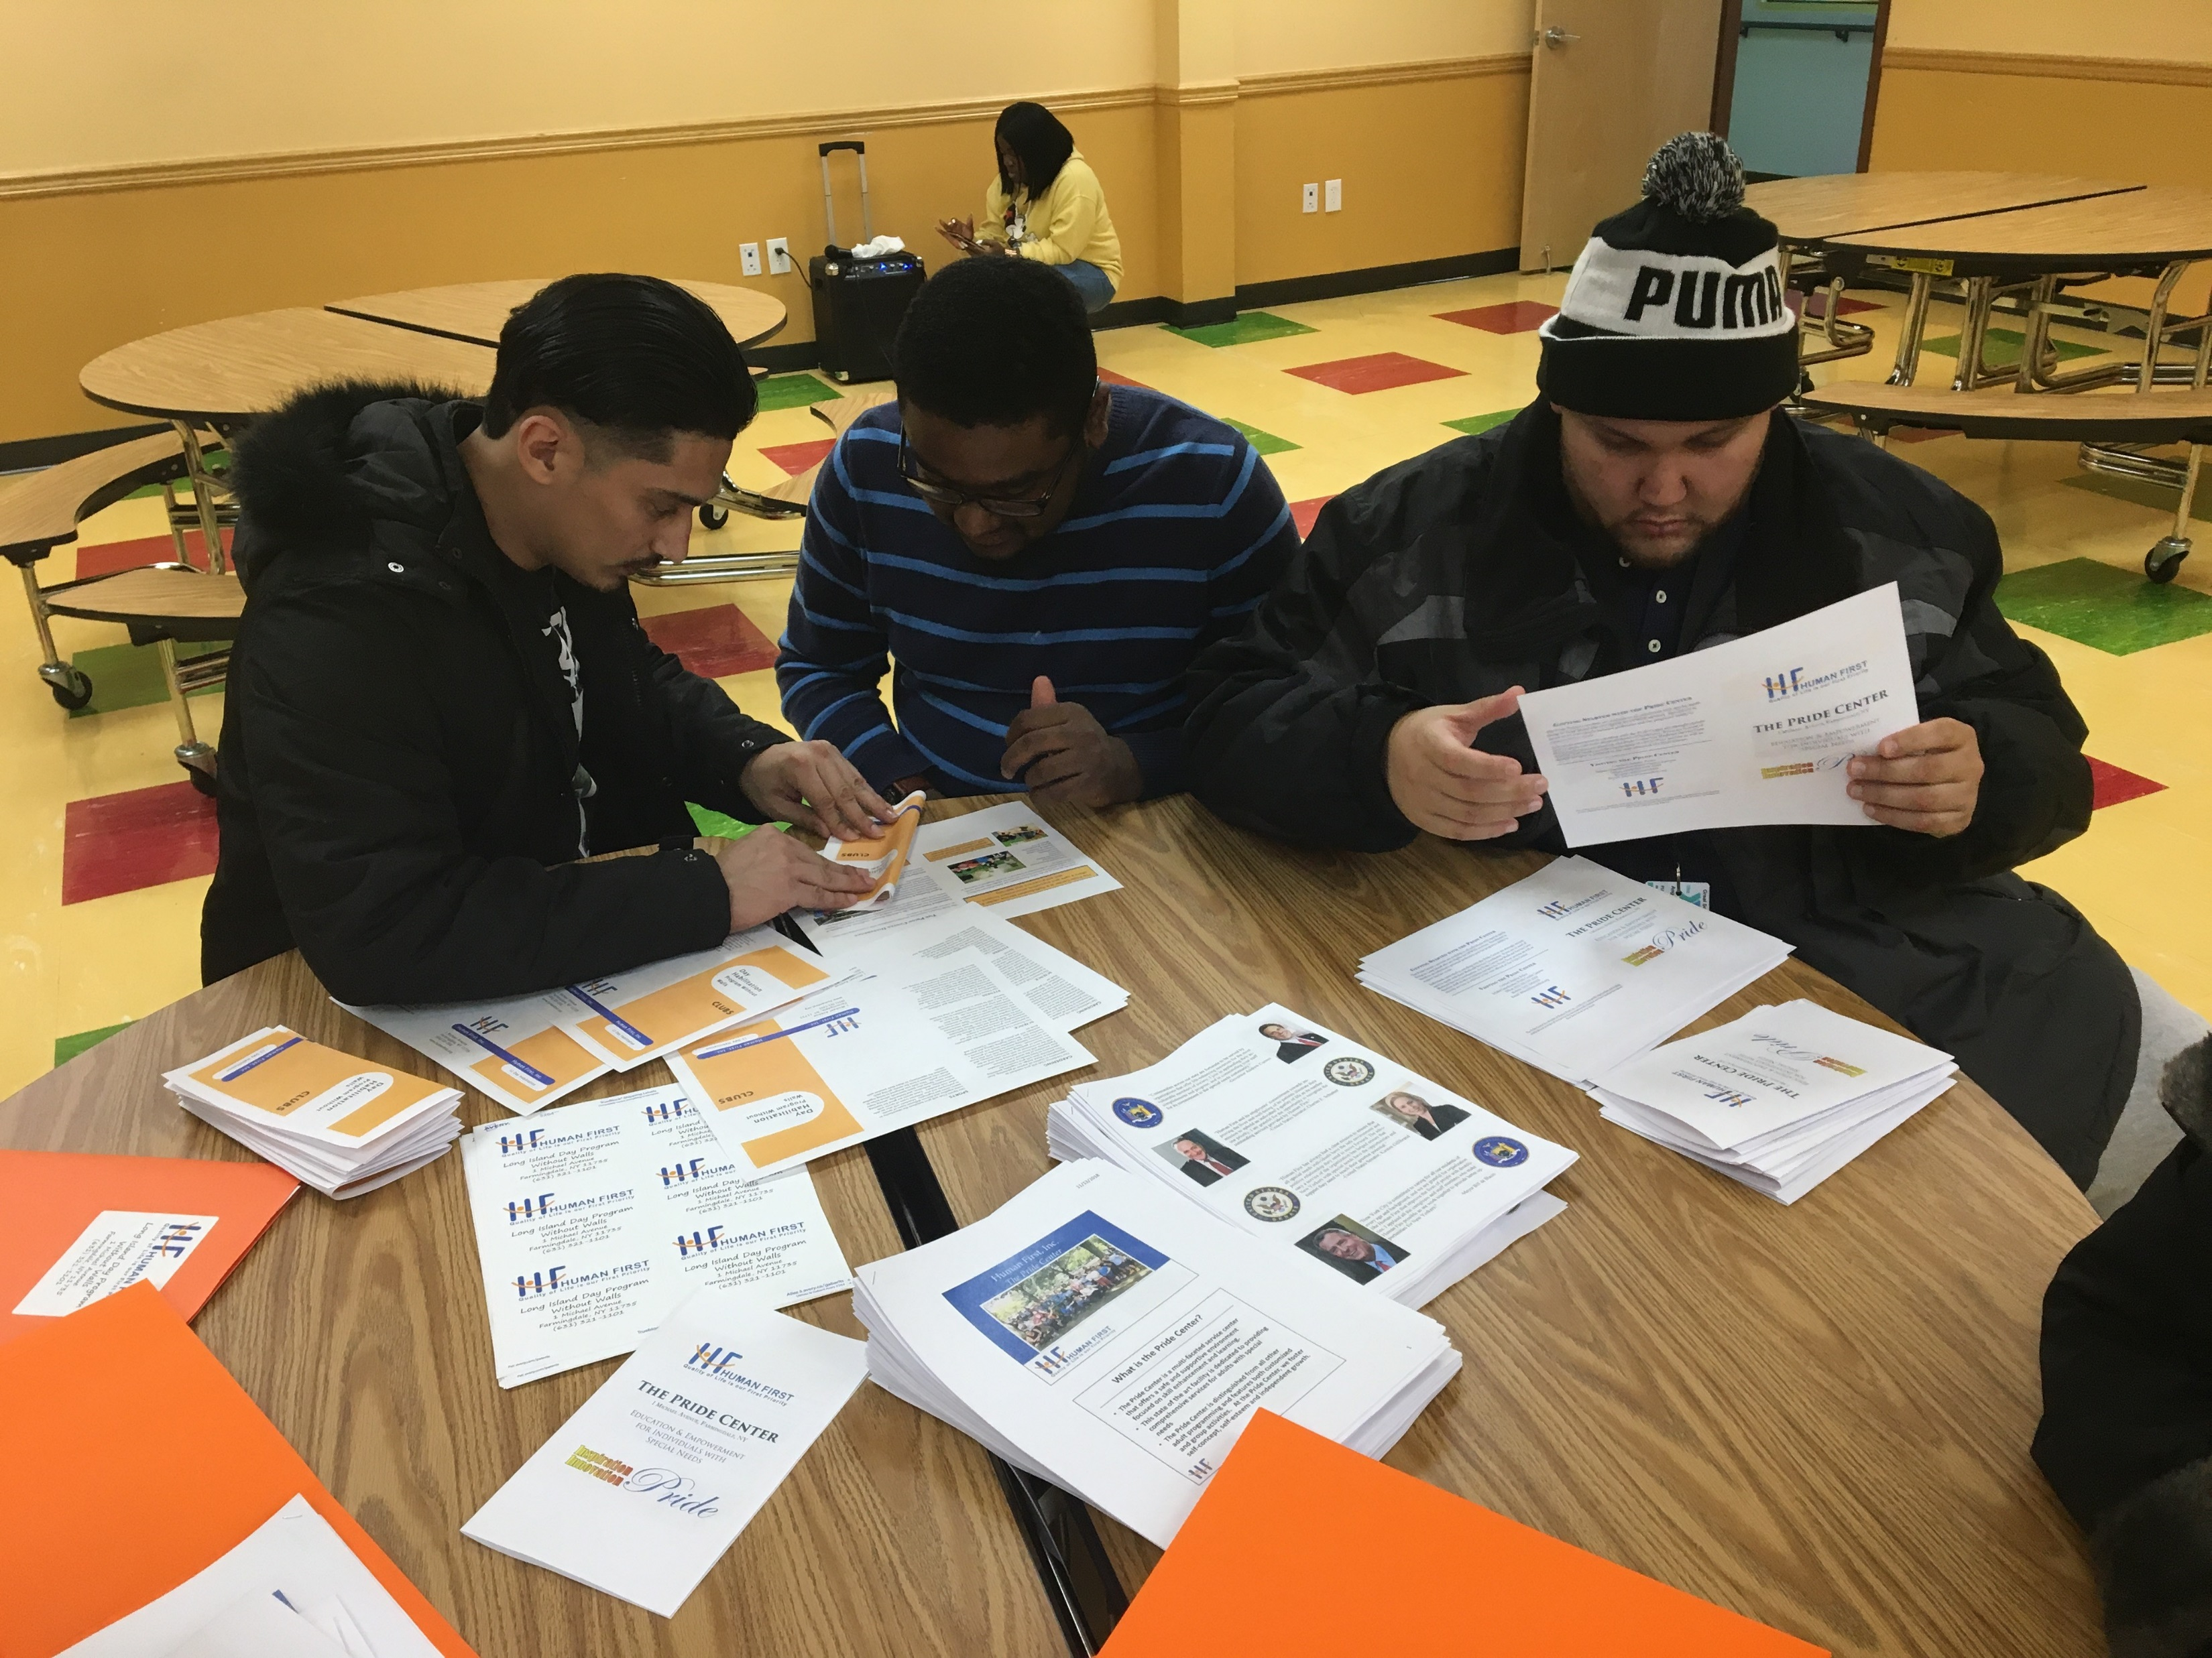
Work readiness

Slide 7
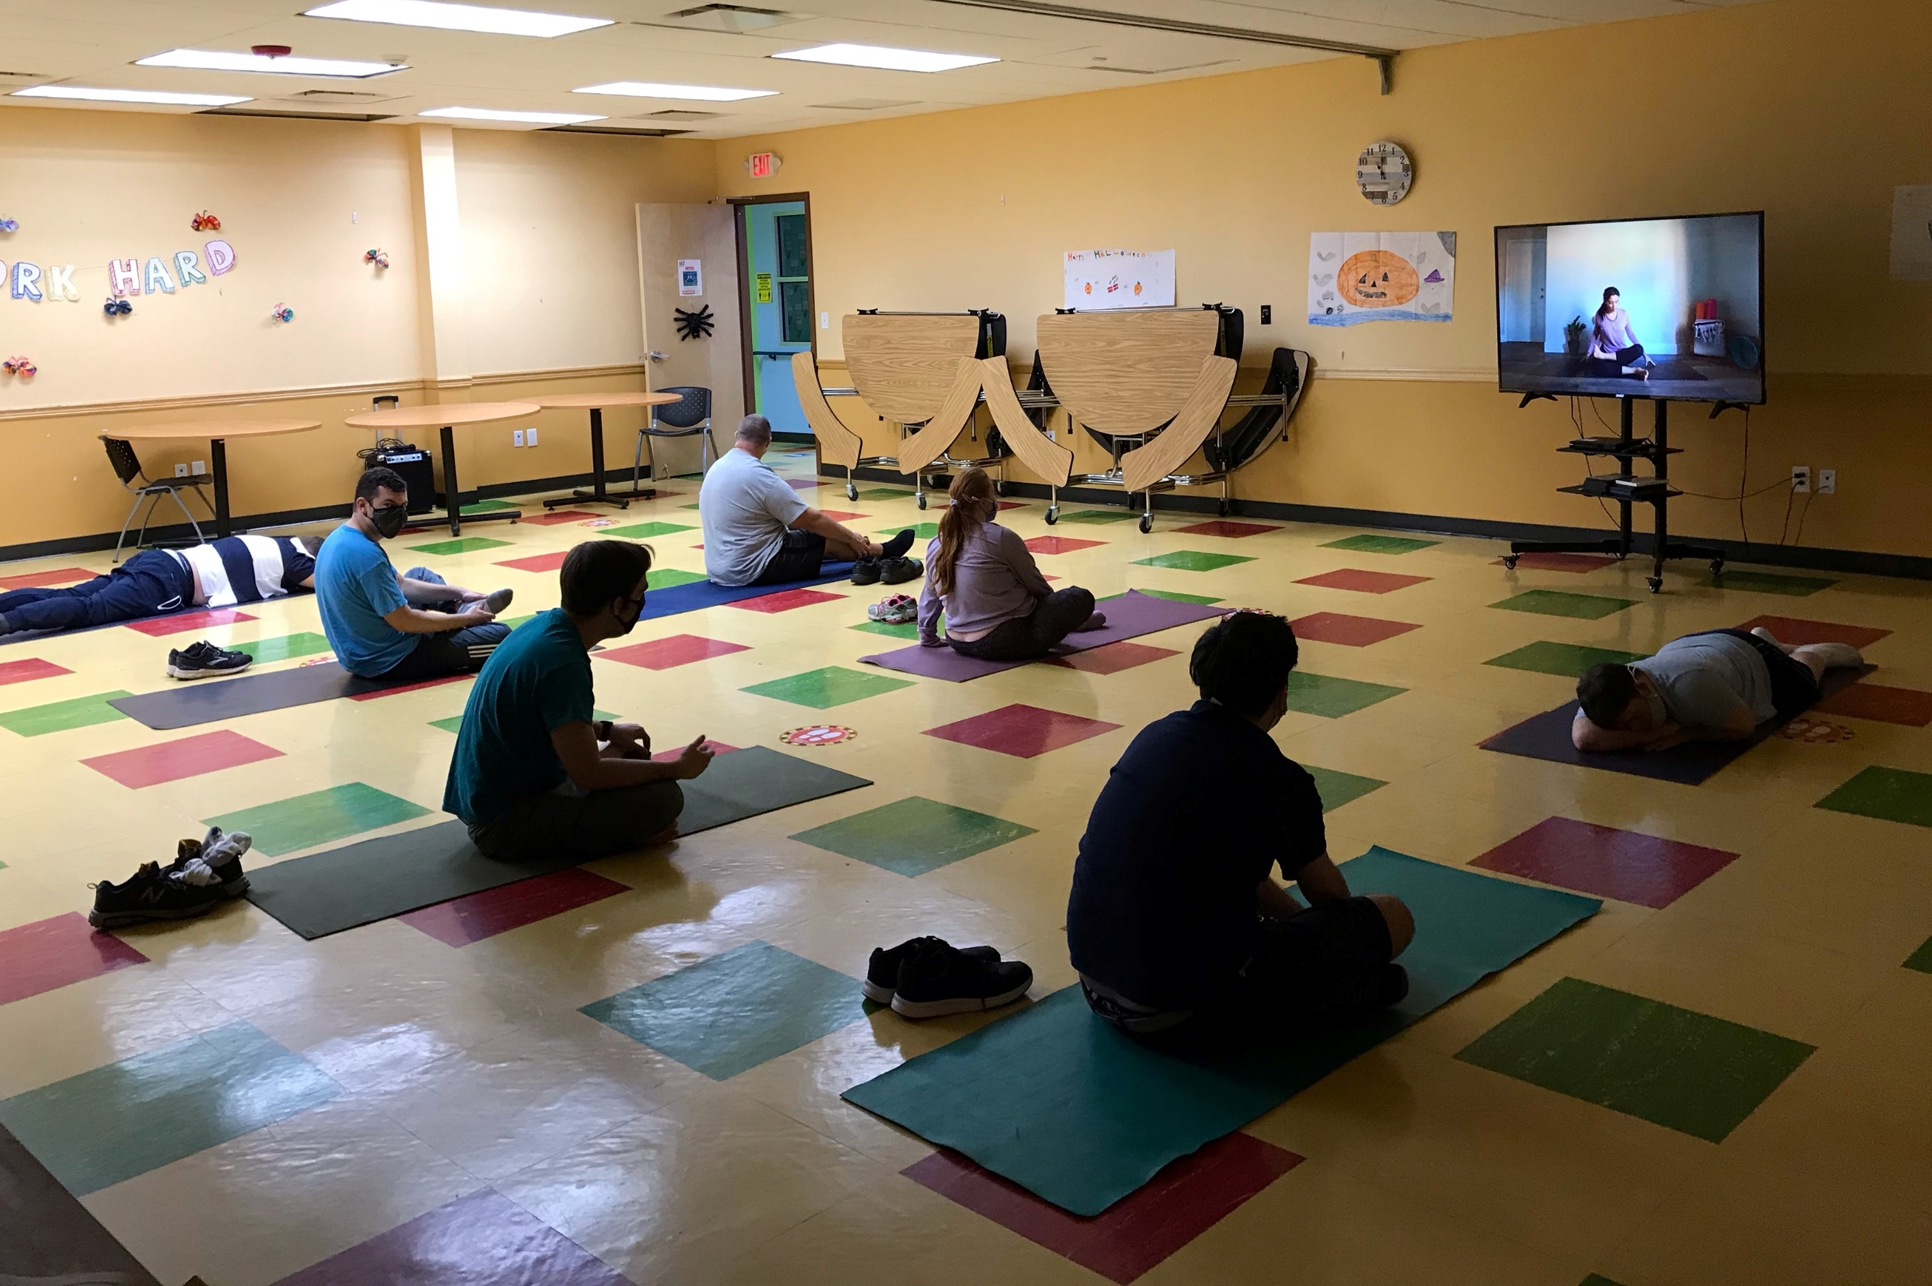
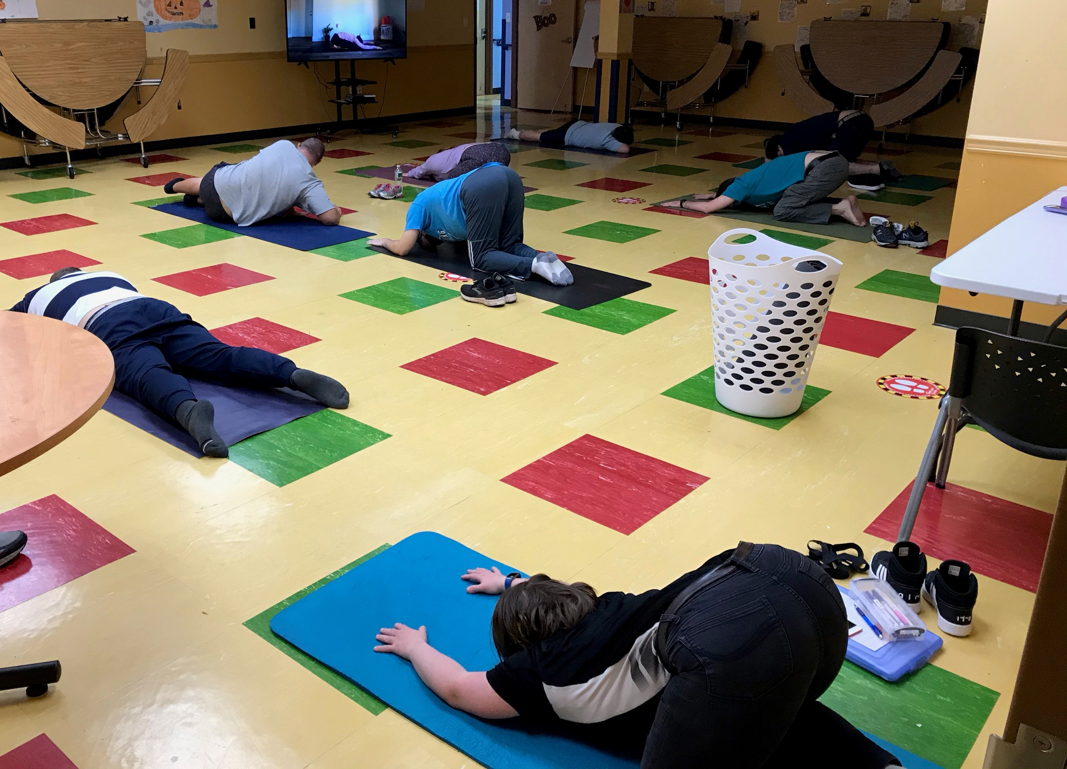
Health & Wellness
Being healthy is one of the most important goals that the people we support choose to work on. Every week, our day habilitation offers opportunities to participate in fitness, Zumba, and yoga classes.

Slide 8
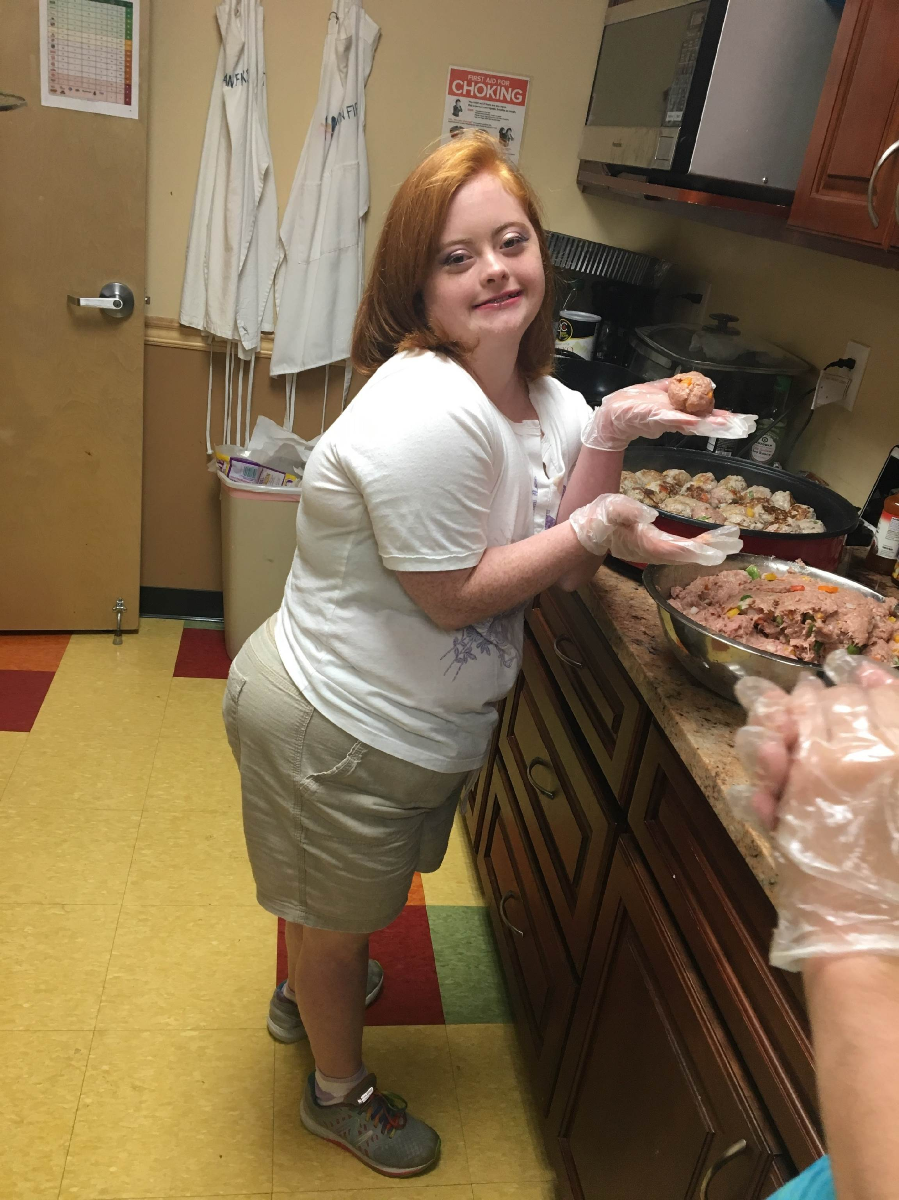
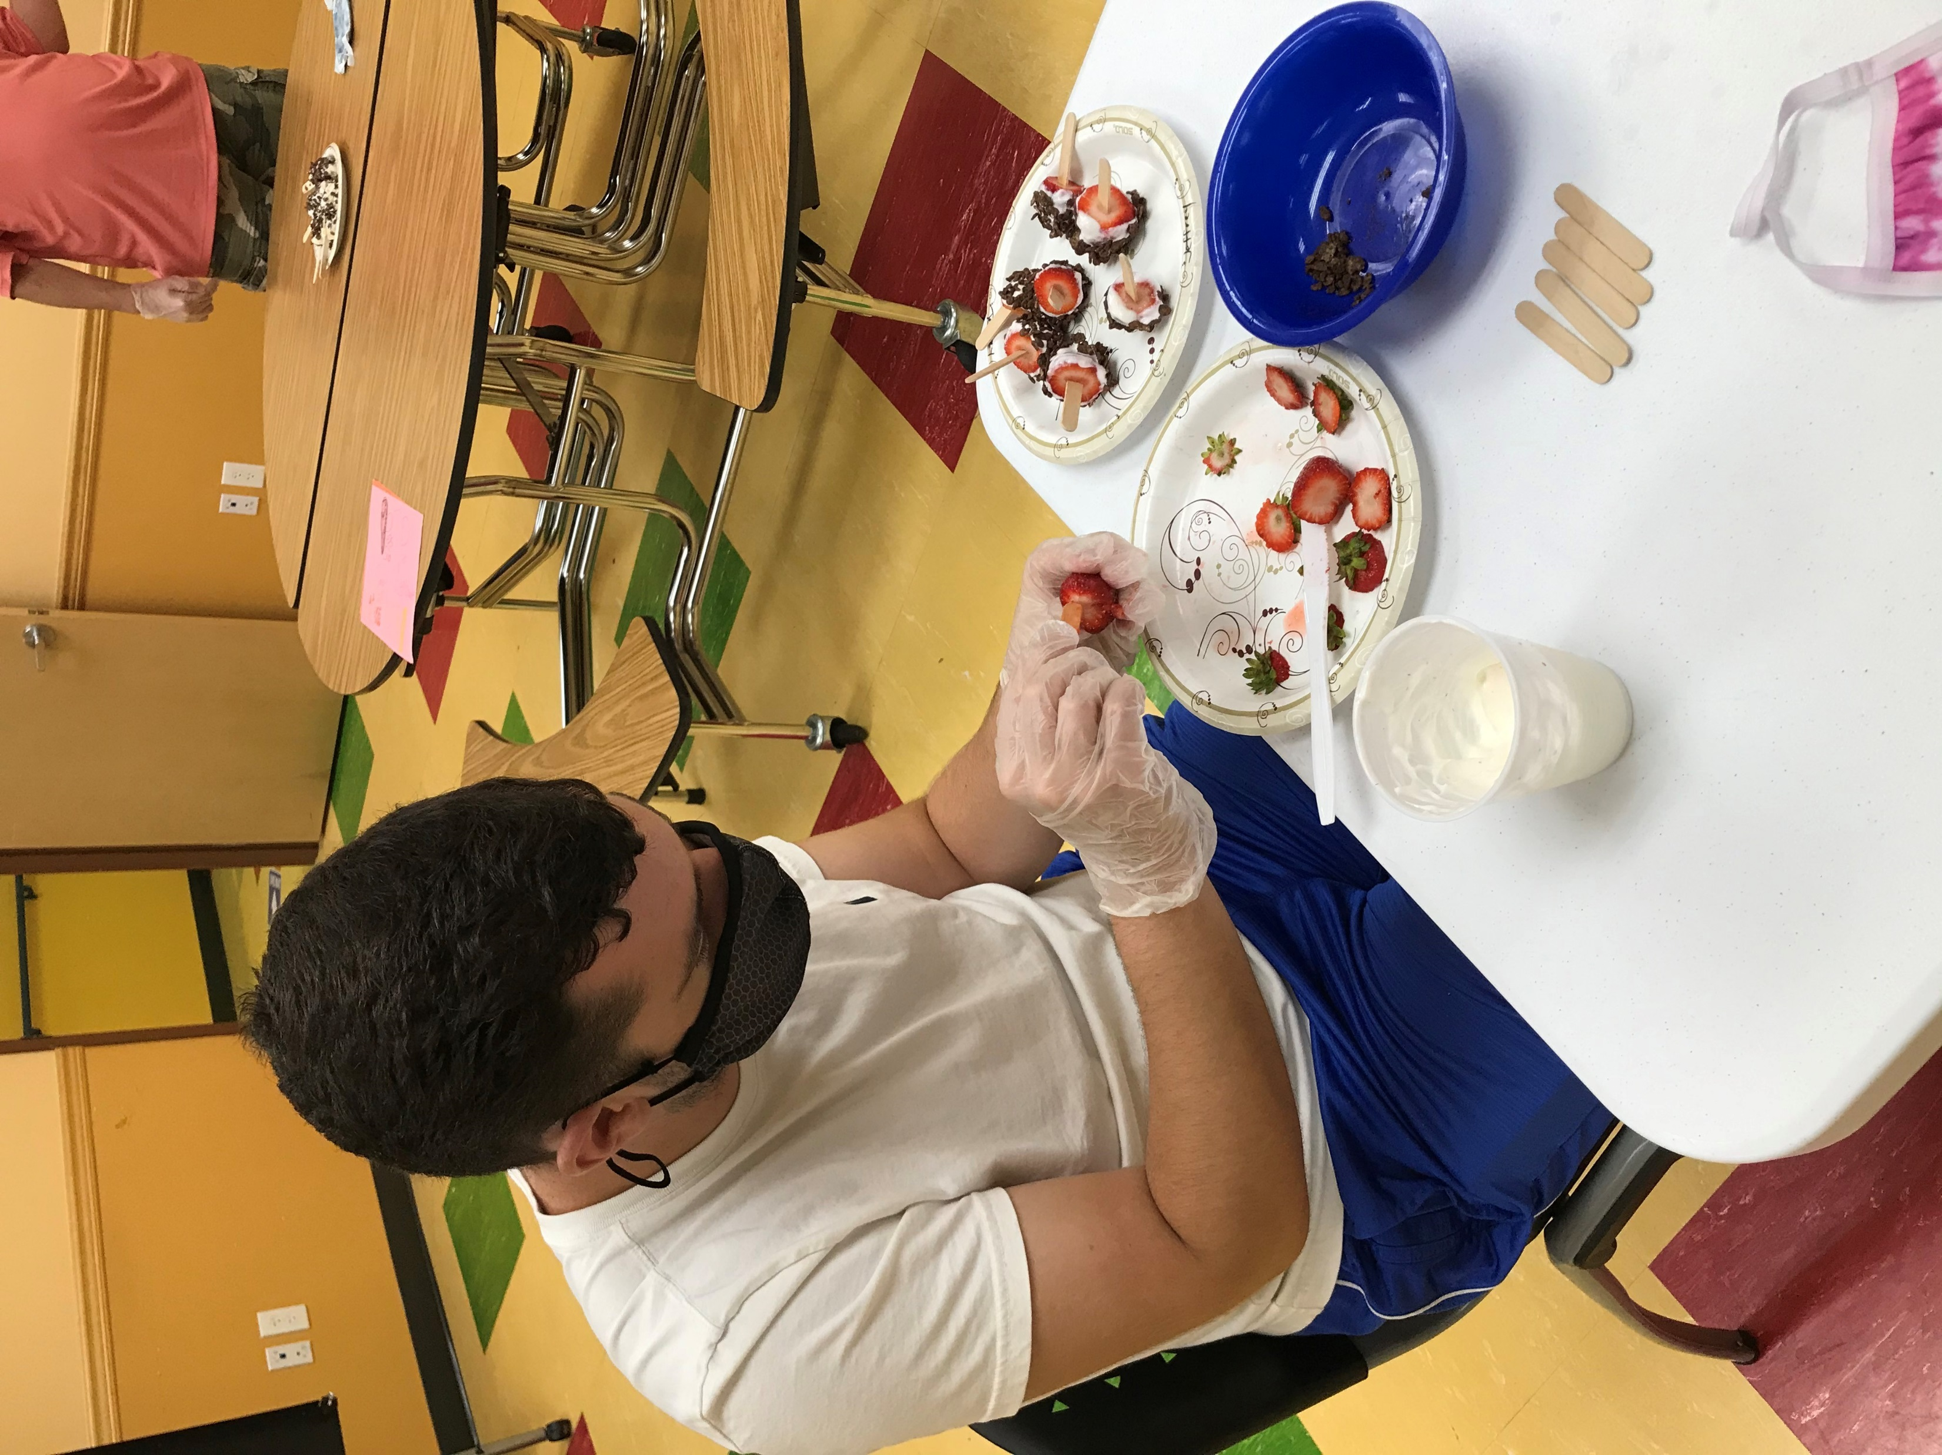
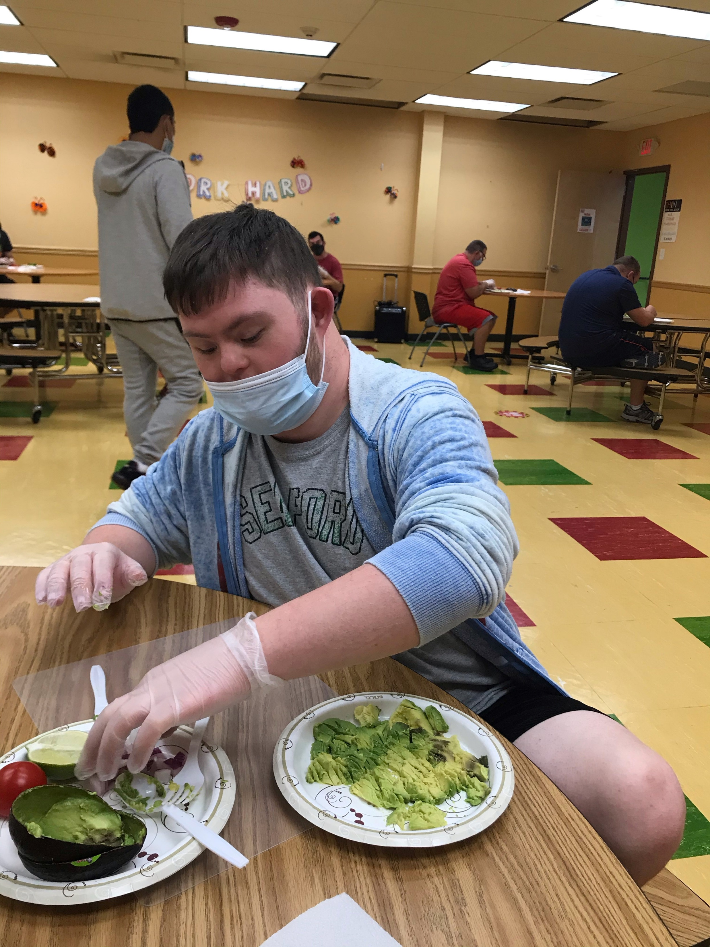
Nutrition & Cooking
Each week, the people we support have the opportunity to learn simple recipes for healthy snacks they can make with their friends and families at home.

Slide 9
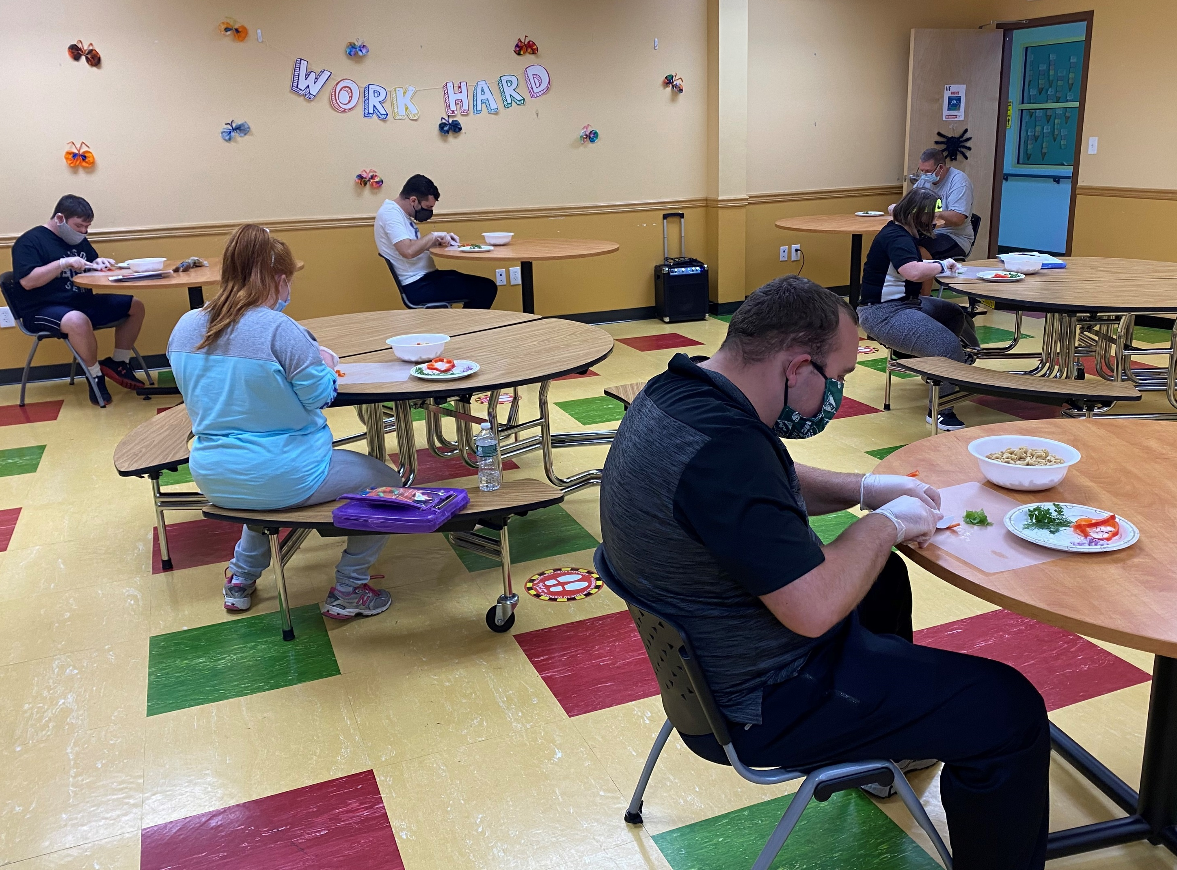
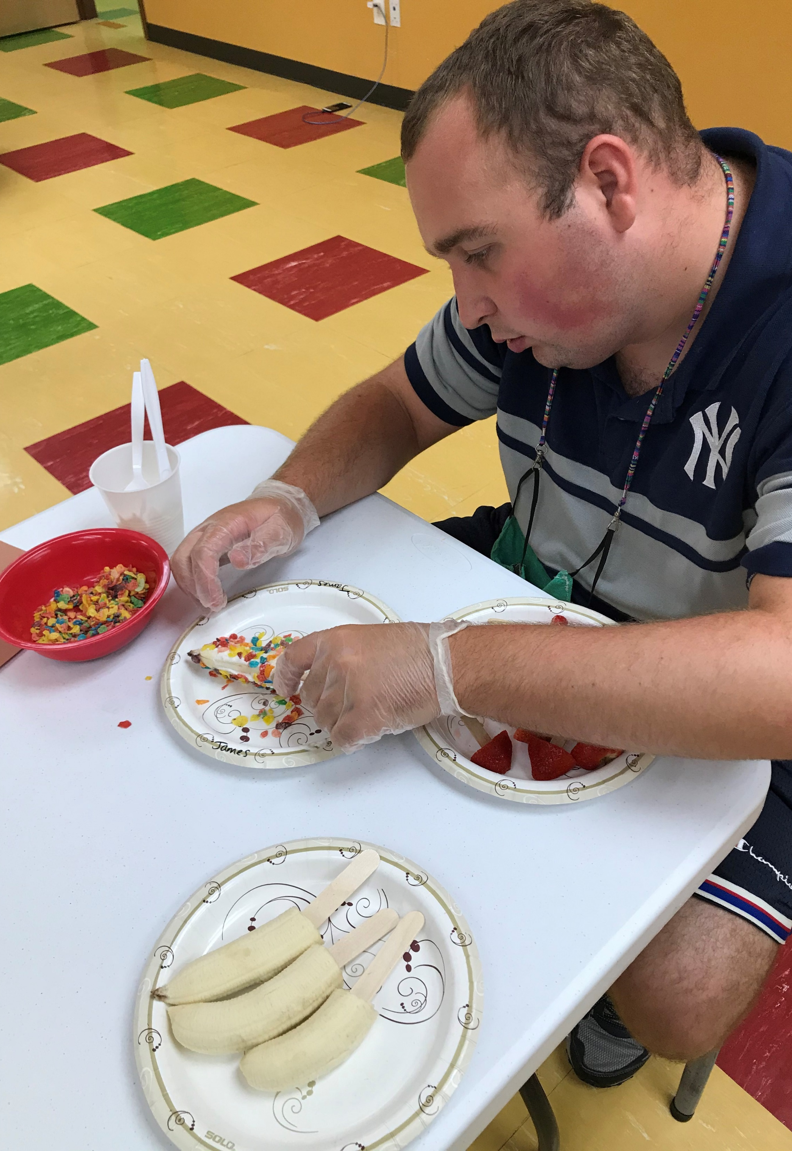
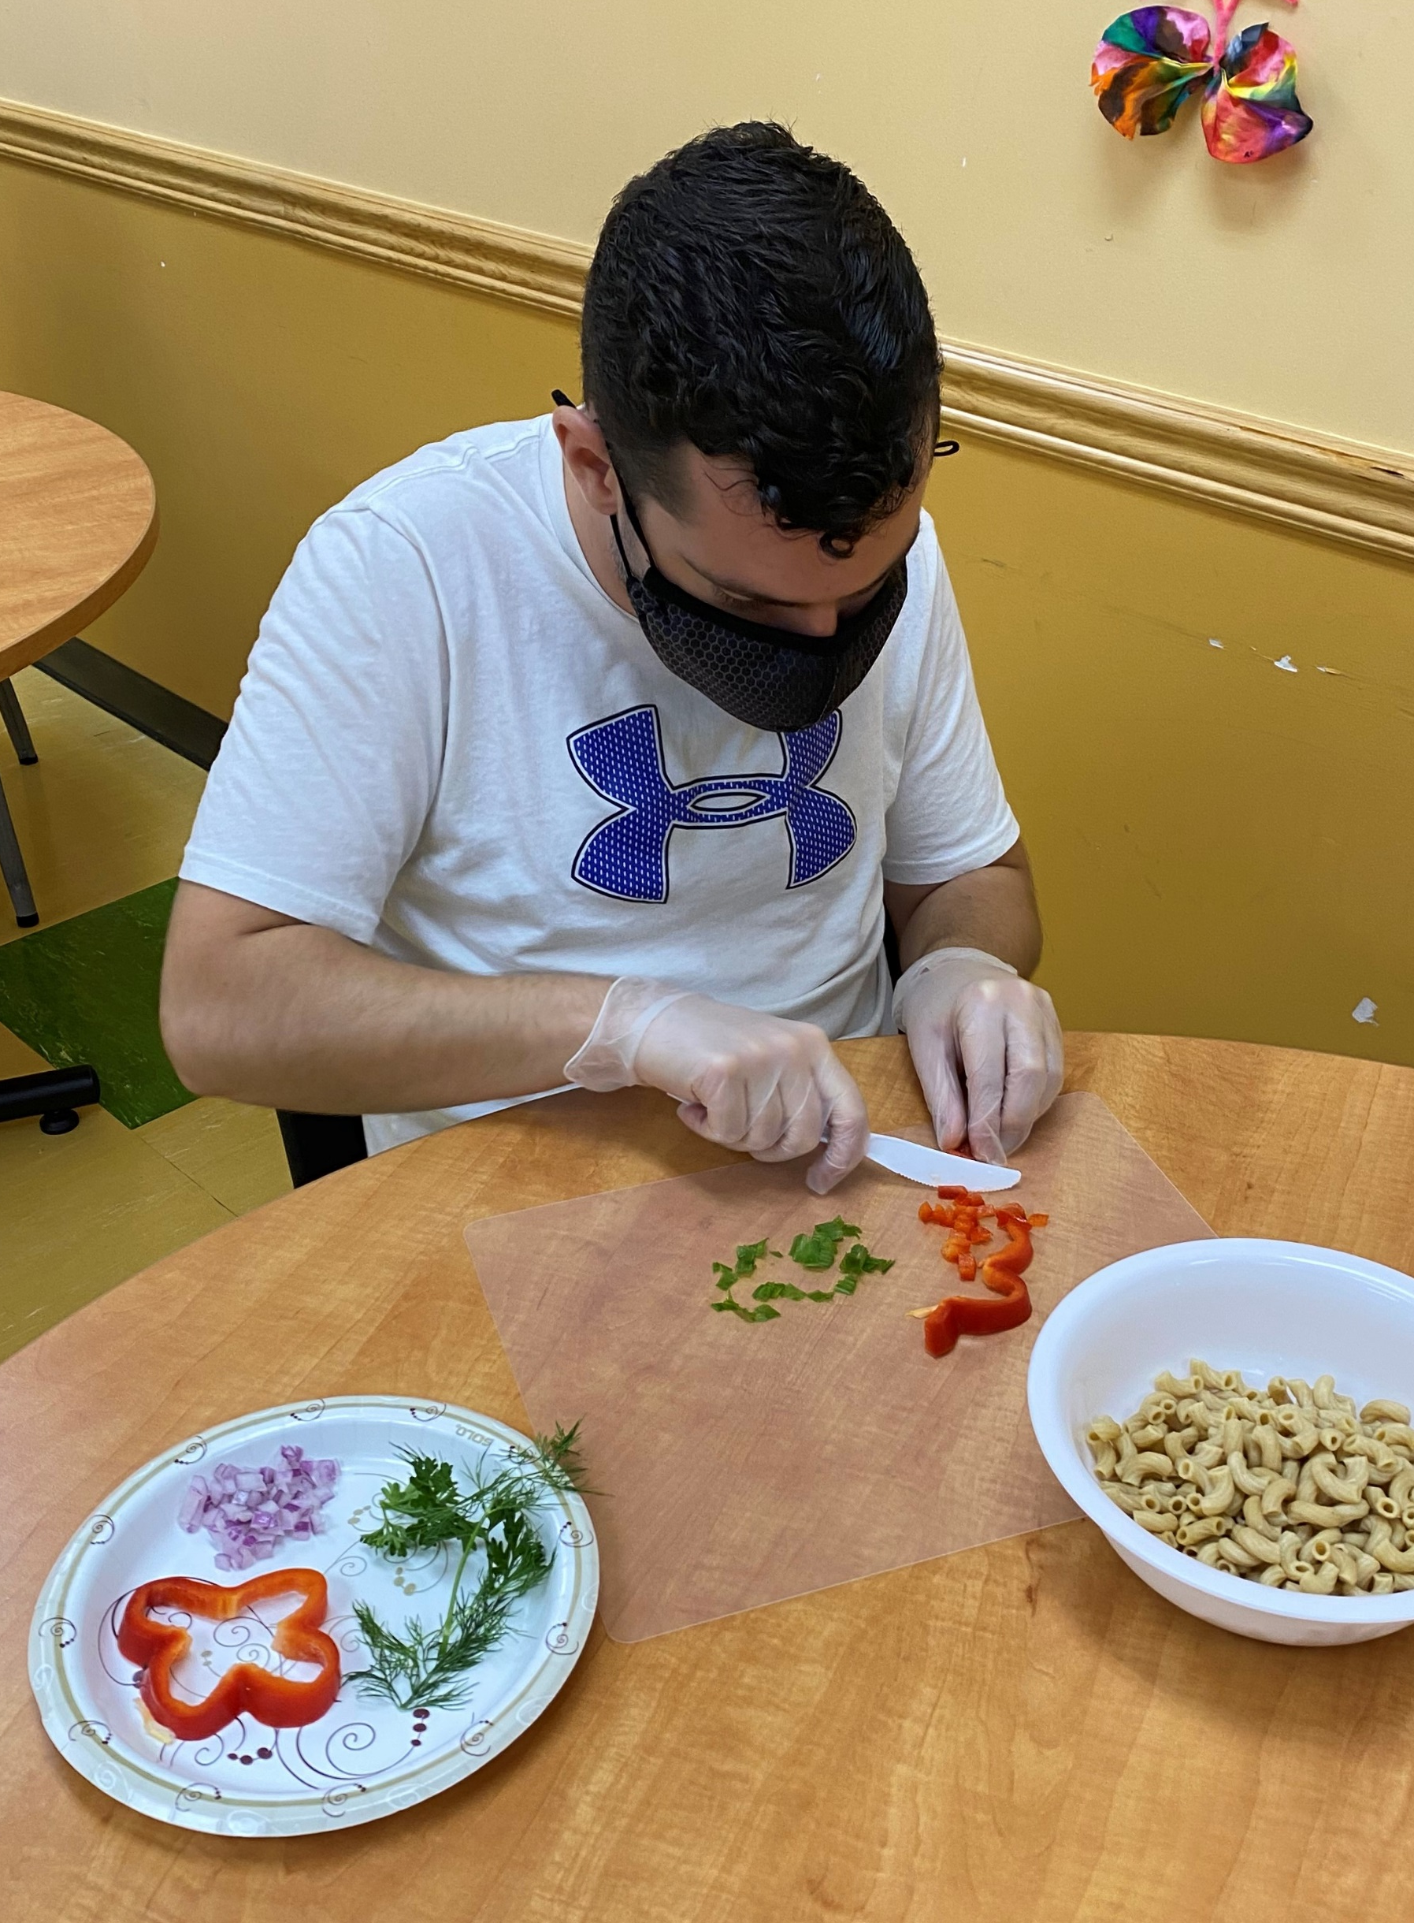
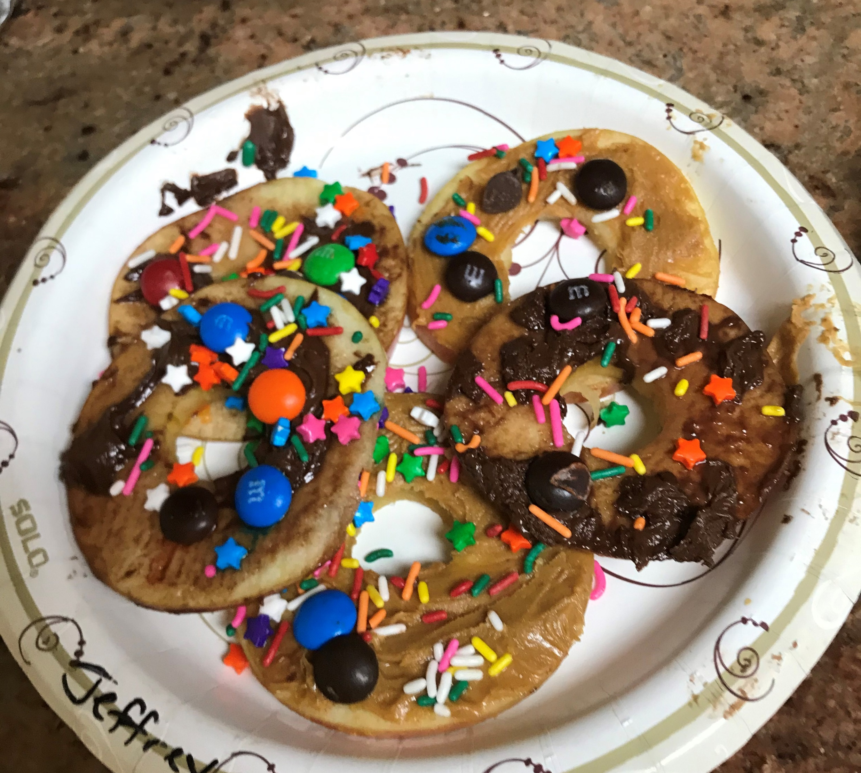

Slide 10
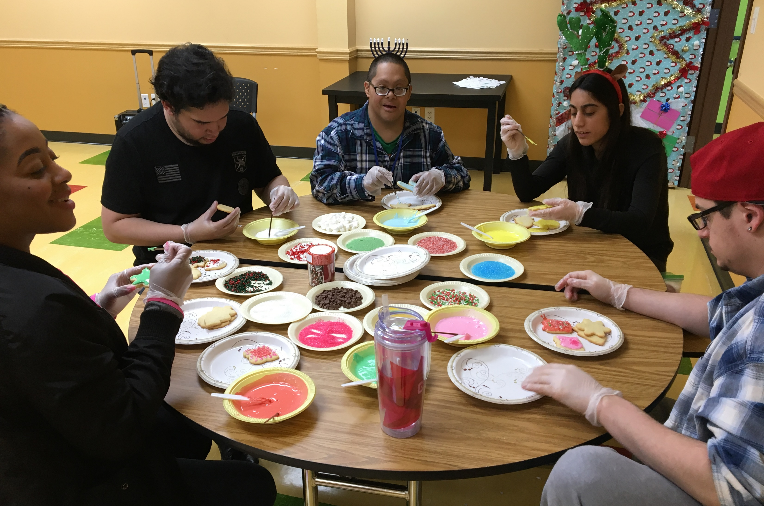
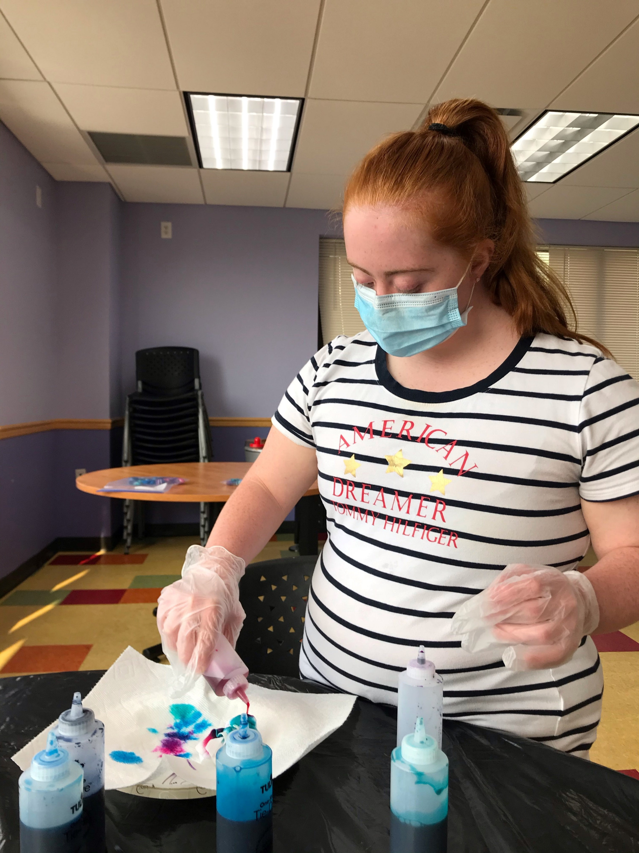
Creative Arts
The people we supported are offered opportunities to be creative on a daily basis. But they especially love the special projects offered during holidays and for agency-wide events!​

Slide 11
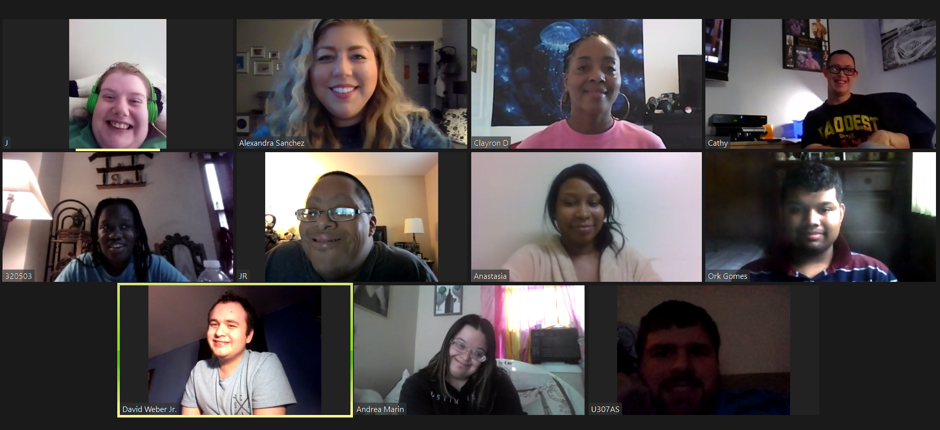
Staying safe while staying home

Slide 12
Virtual Day Habilitation
Starting 3/24/2020, our program has been offered virtually via Zoom, in small groups operating from 9:30am through 1:30pm.

Slide 13
Re-opening Day Habilitation
Beginning 8/9/2020, our Farmingdale location re-opened its doors,
at a limited capacity. The building is now equipped with social distancing
floor and wall decals, tables in service areas have been spaced 6 feet apart,
and sanitizing/cleaning stations have been added to each room. The program area is cleaned and sanitized three times a day and the program vehicles are sanitized before/after each use.
All staff and persons supported have their temperatures taken daily.
Staff wear their masks and all times, and the people we support wear
their masks for as long as they are able.

Slide 14
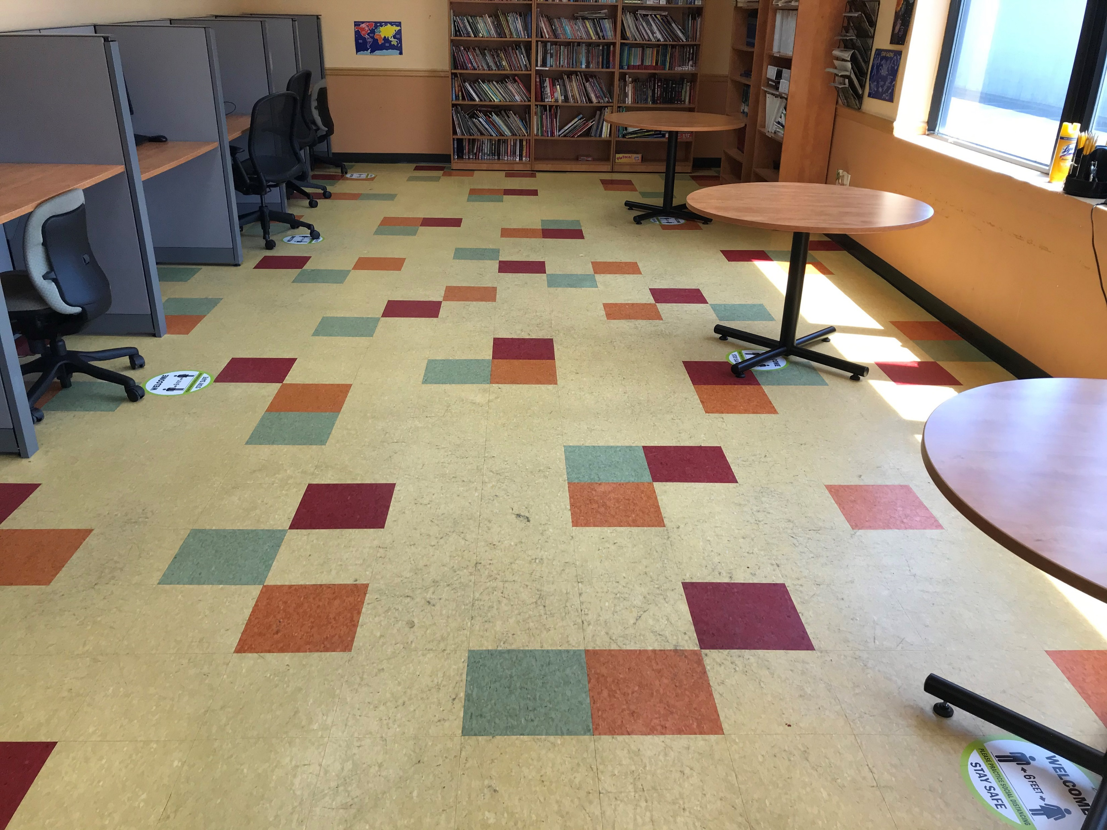
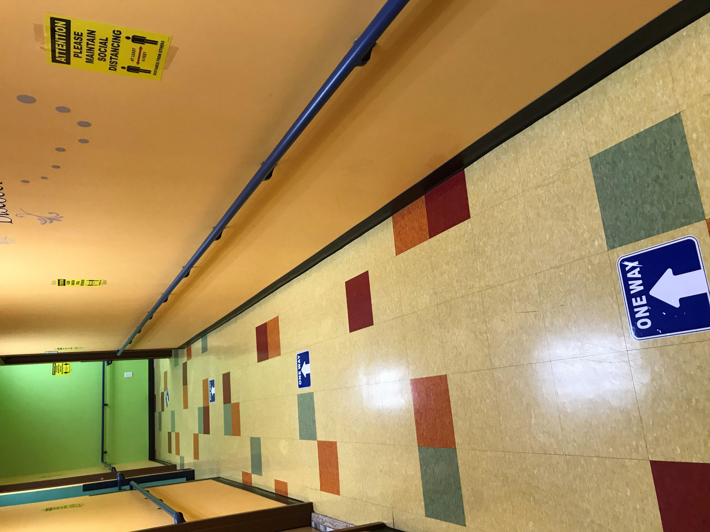
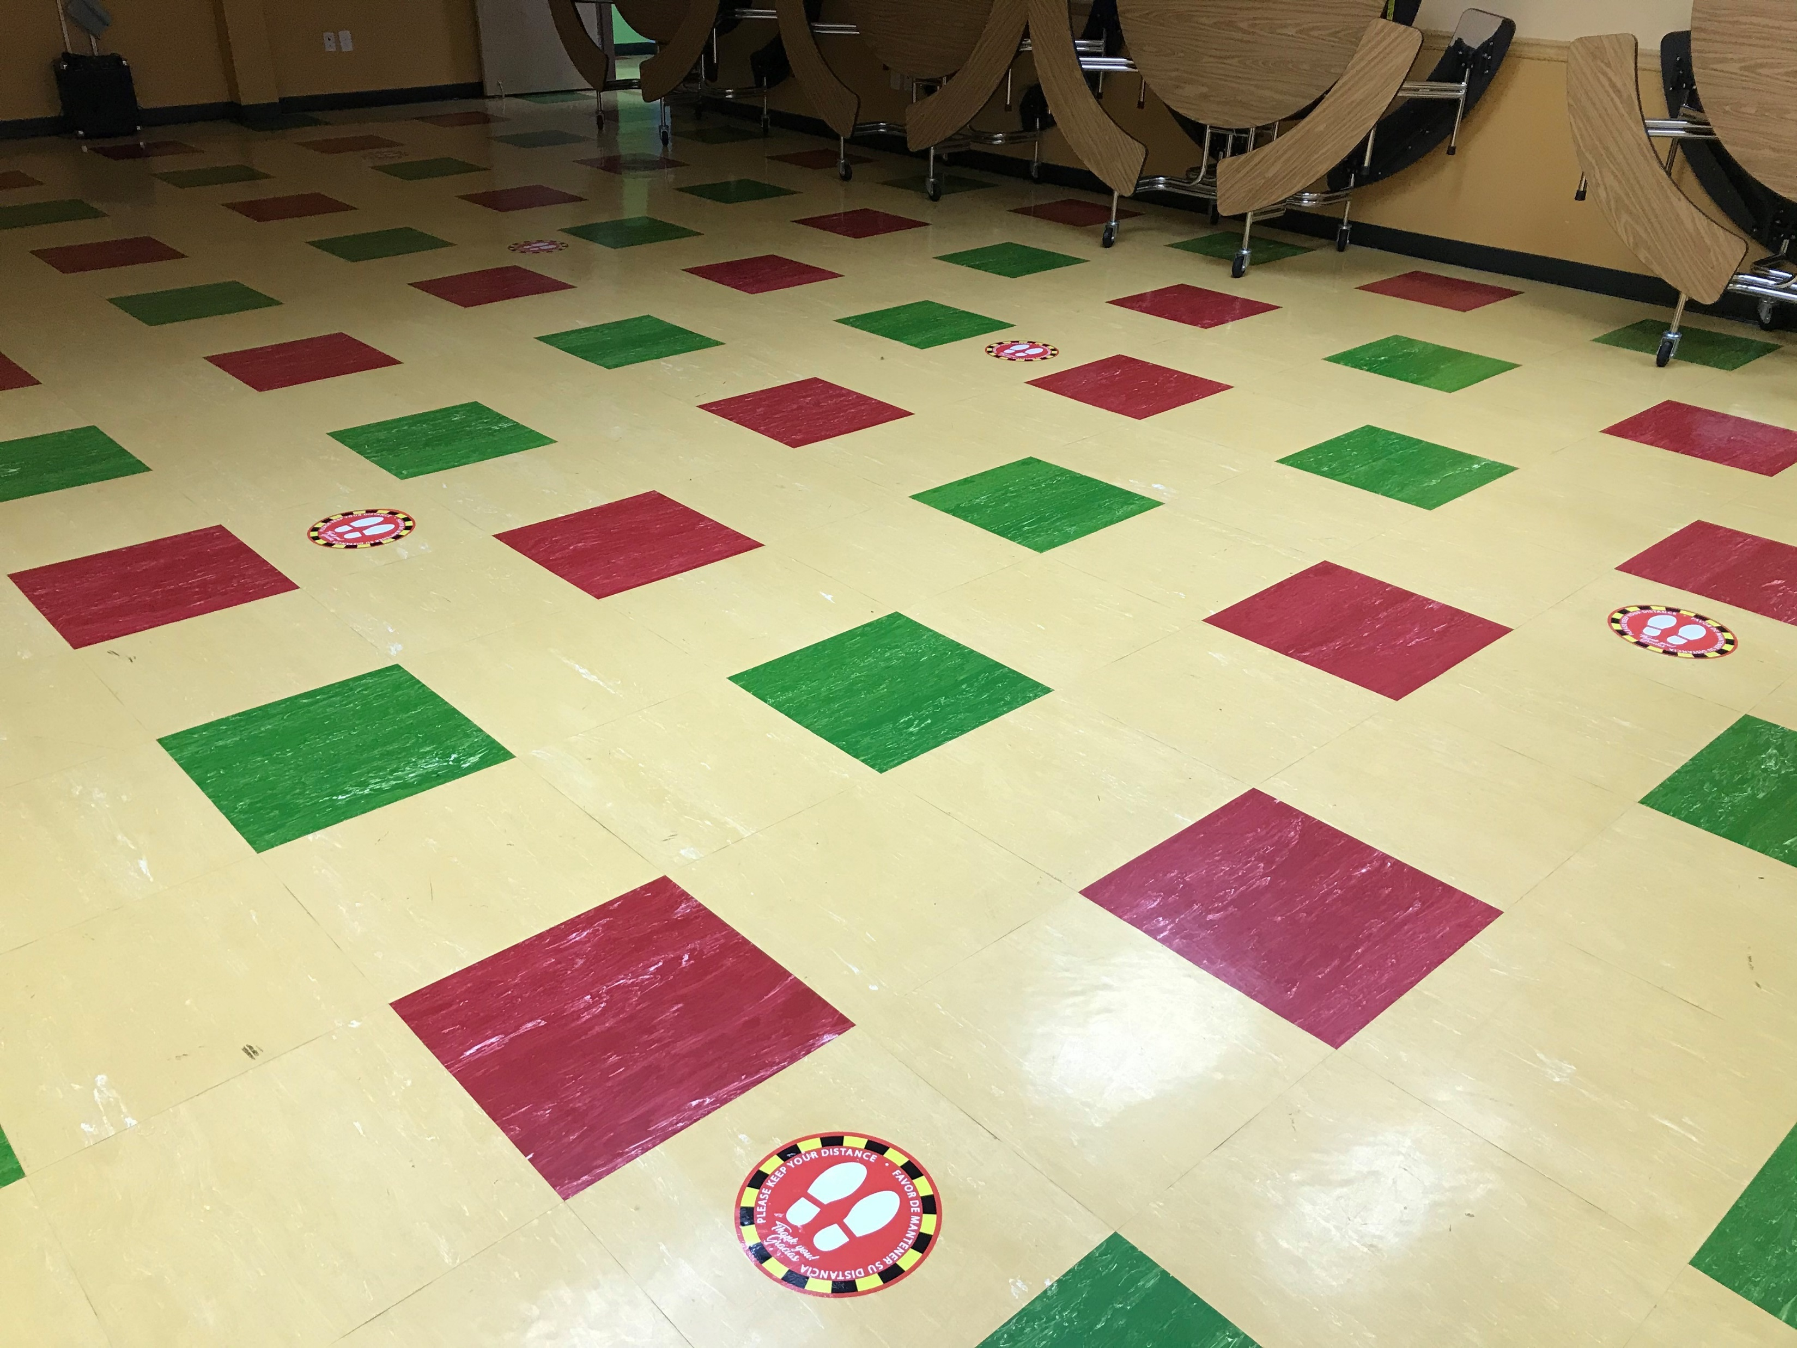
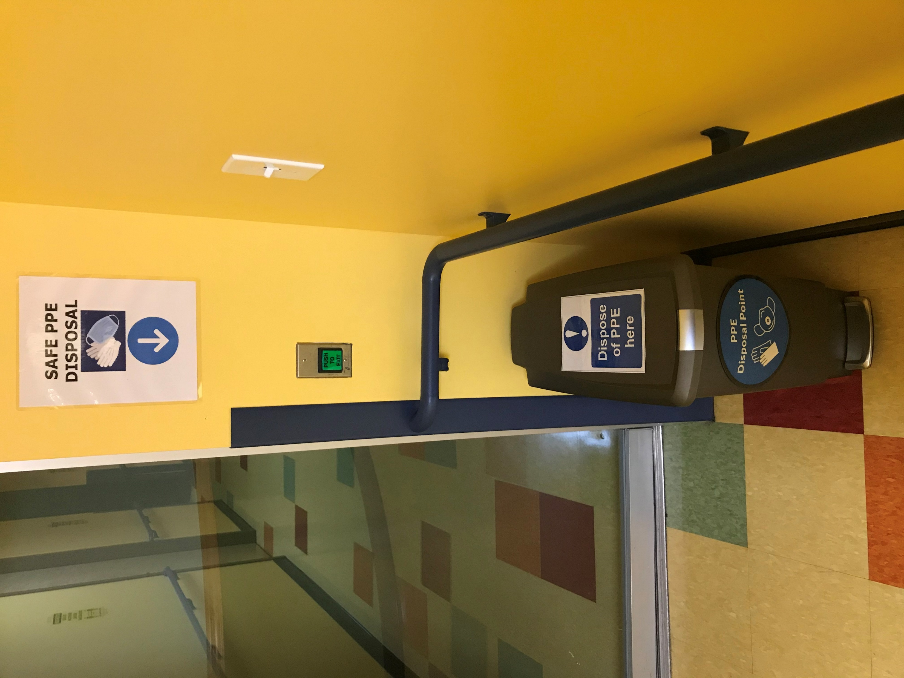

Slide 15
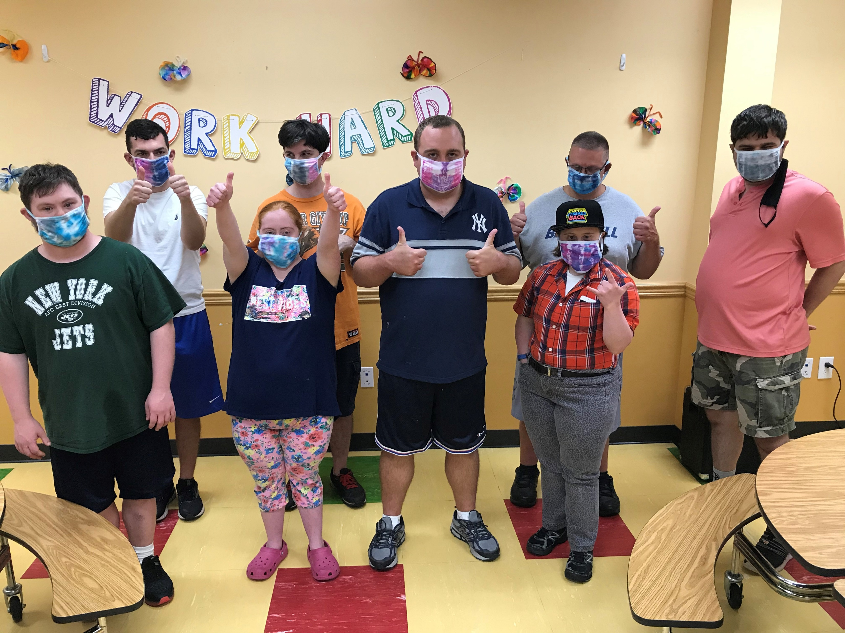

Slide 16
Day Habilitation & the community
The health and safety of the people we support and our staff is our priority. Community trips have been limited to locations where we can remain outdoors, or if indoors, where we can maintain social distancing and avoid large groups.
All staff and persons supported are required to wear their masks when in the community, and each program vehicle is equipped with hand sanitizer, gloves, and cleaning supplies.

Slide 17
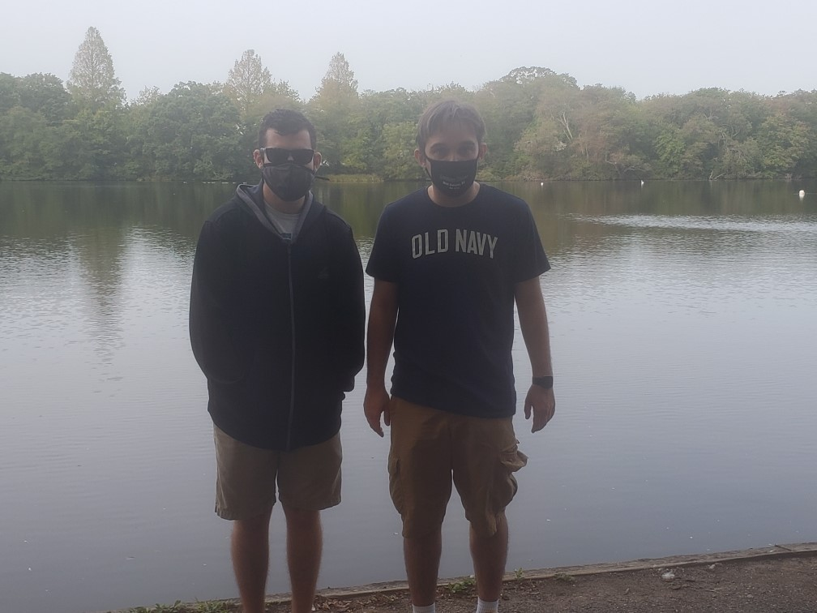
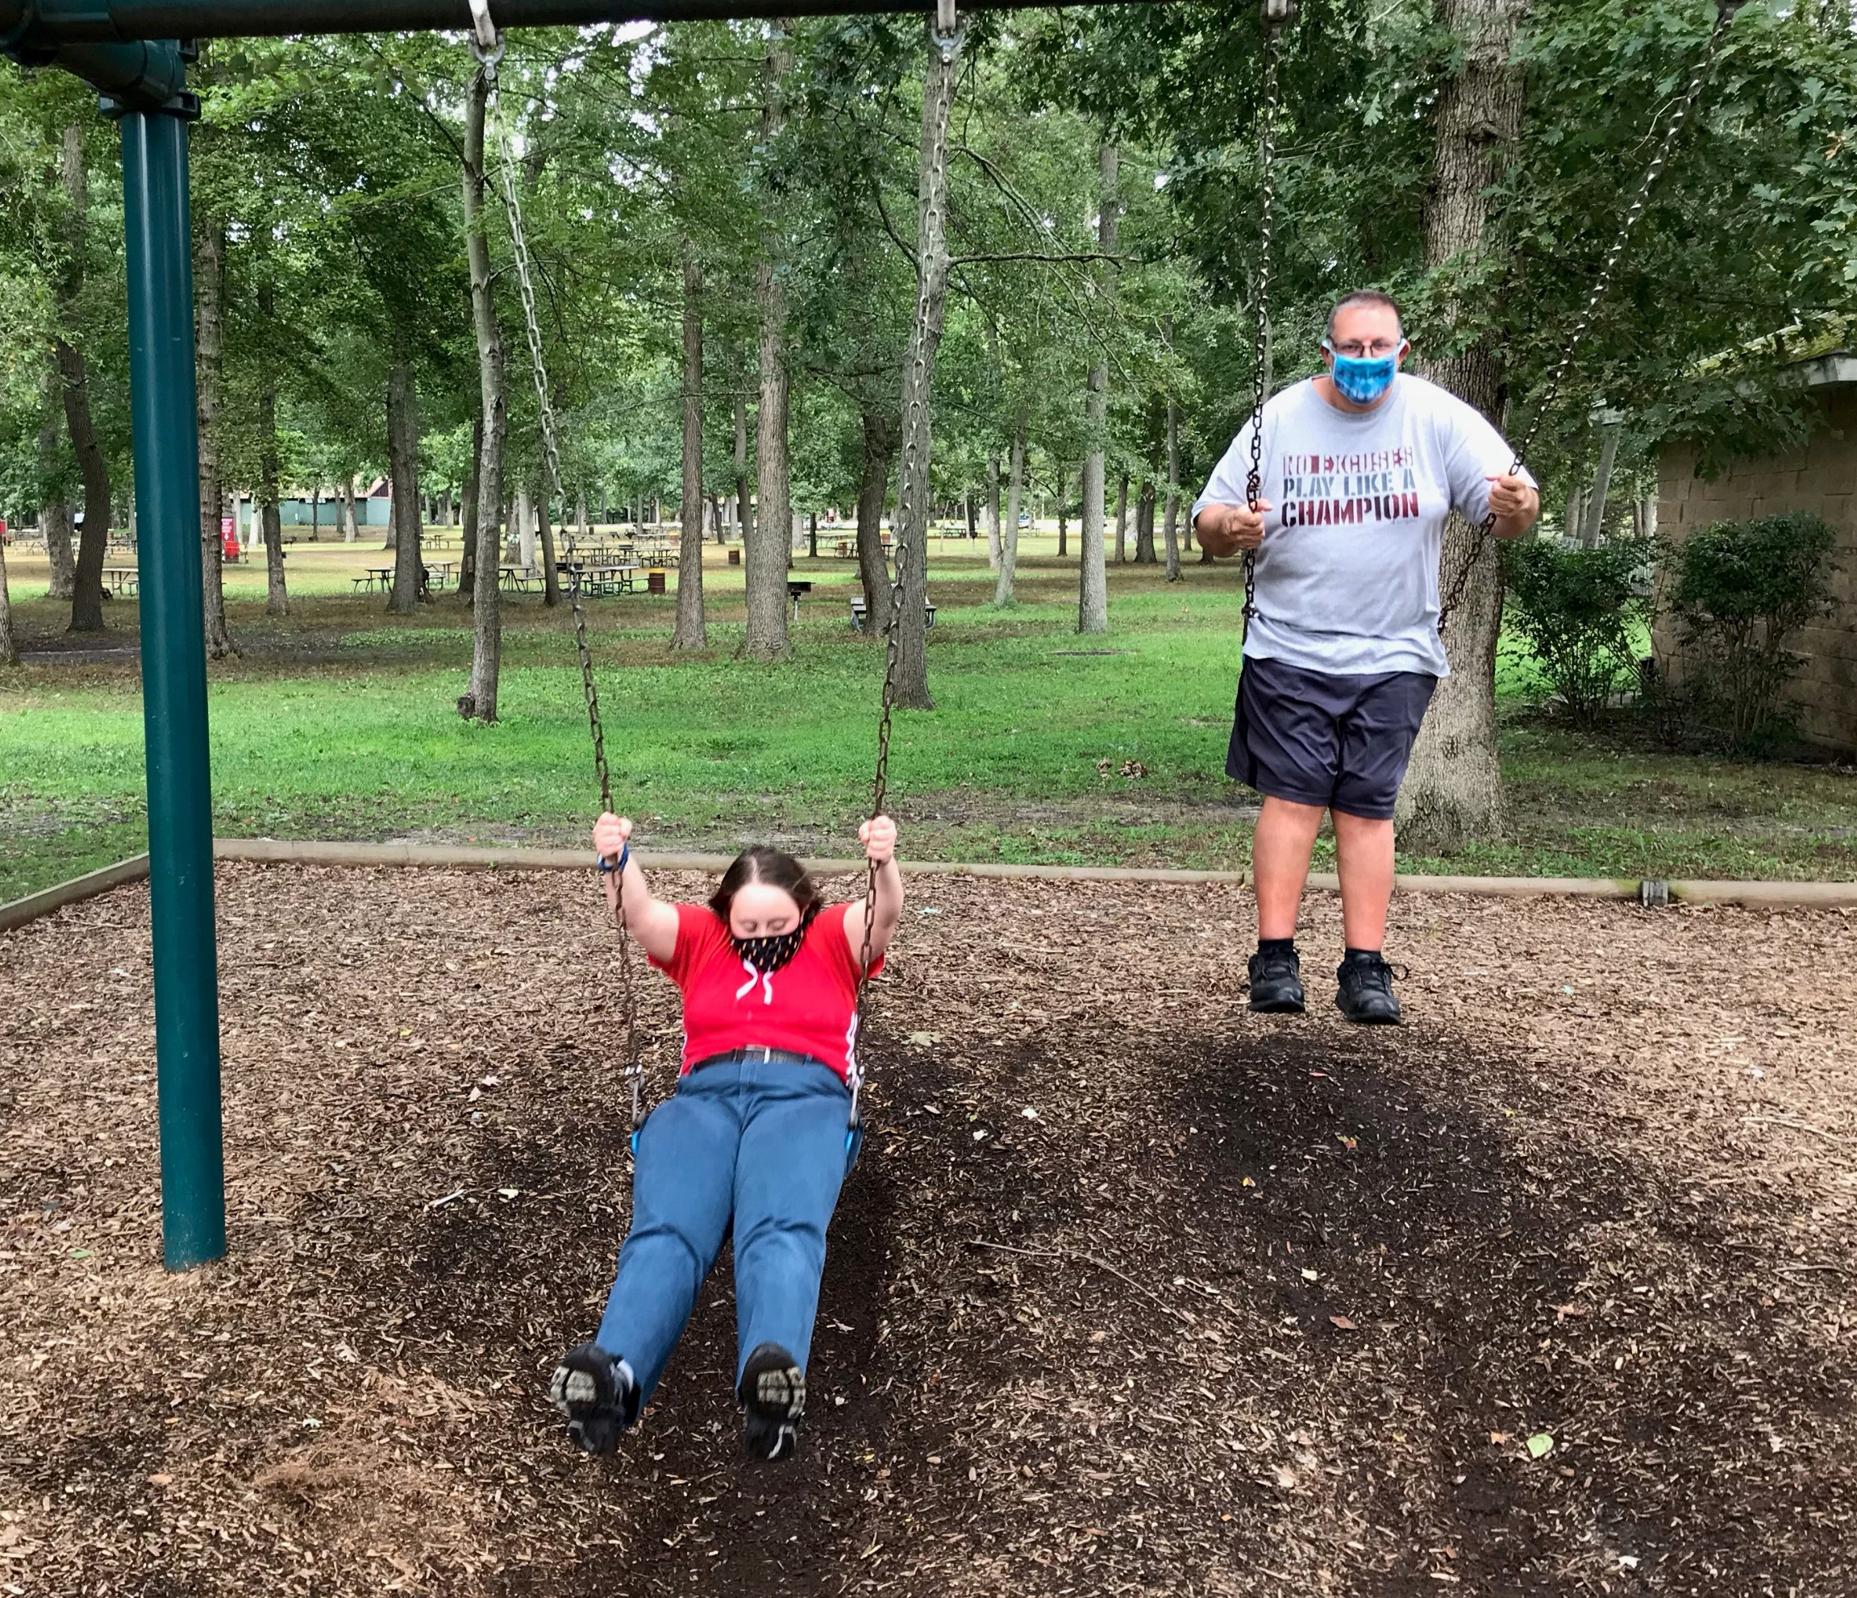
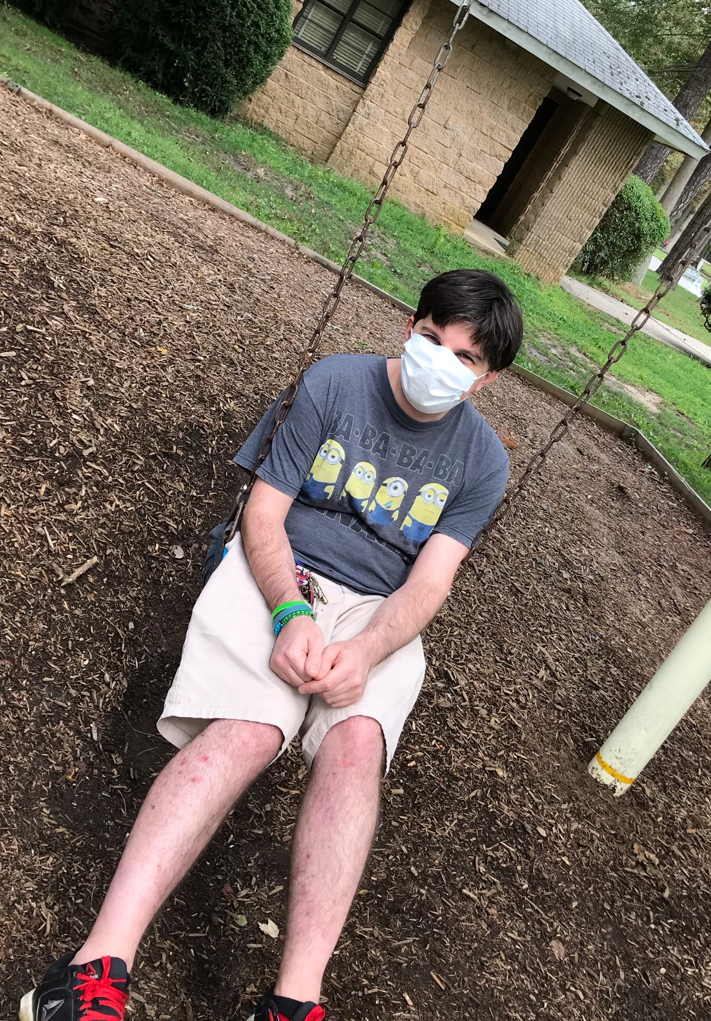
Staying safe in the community

Slide 18
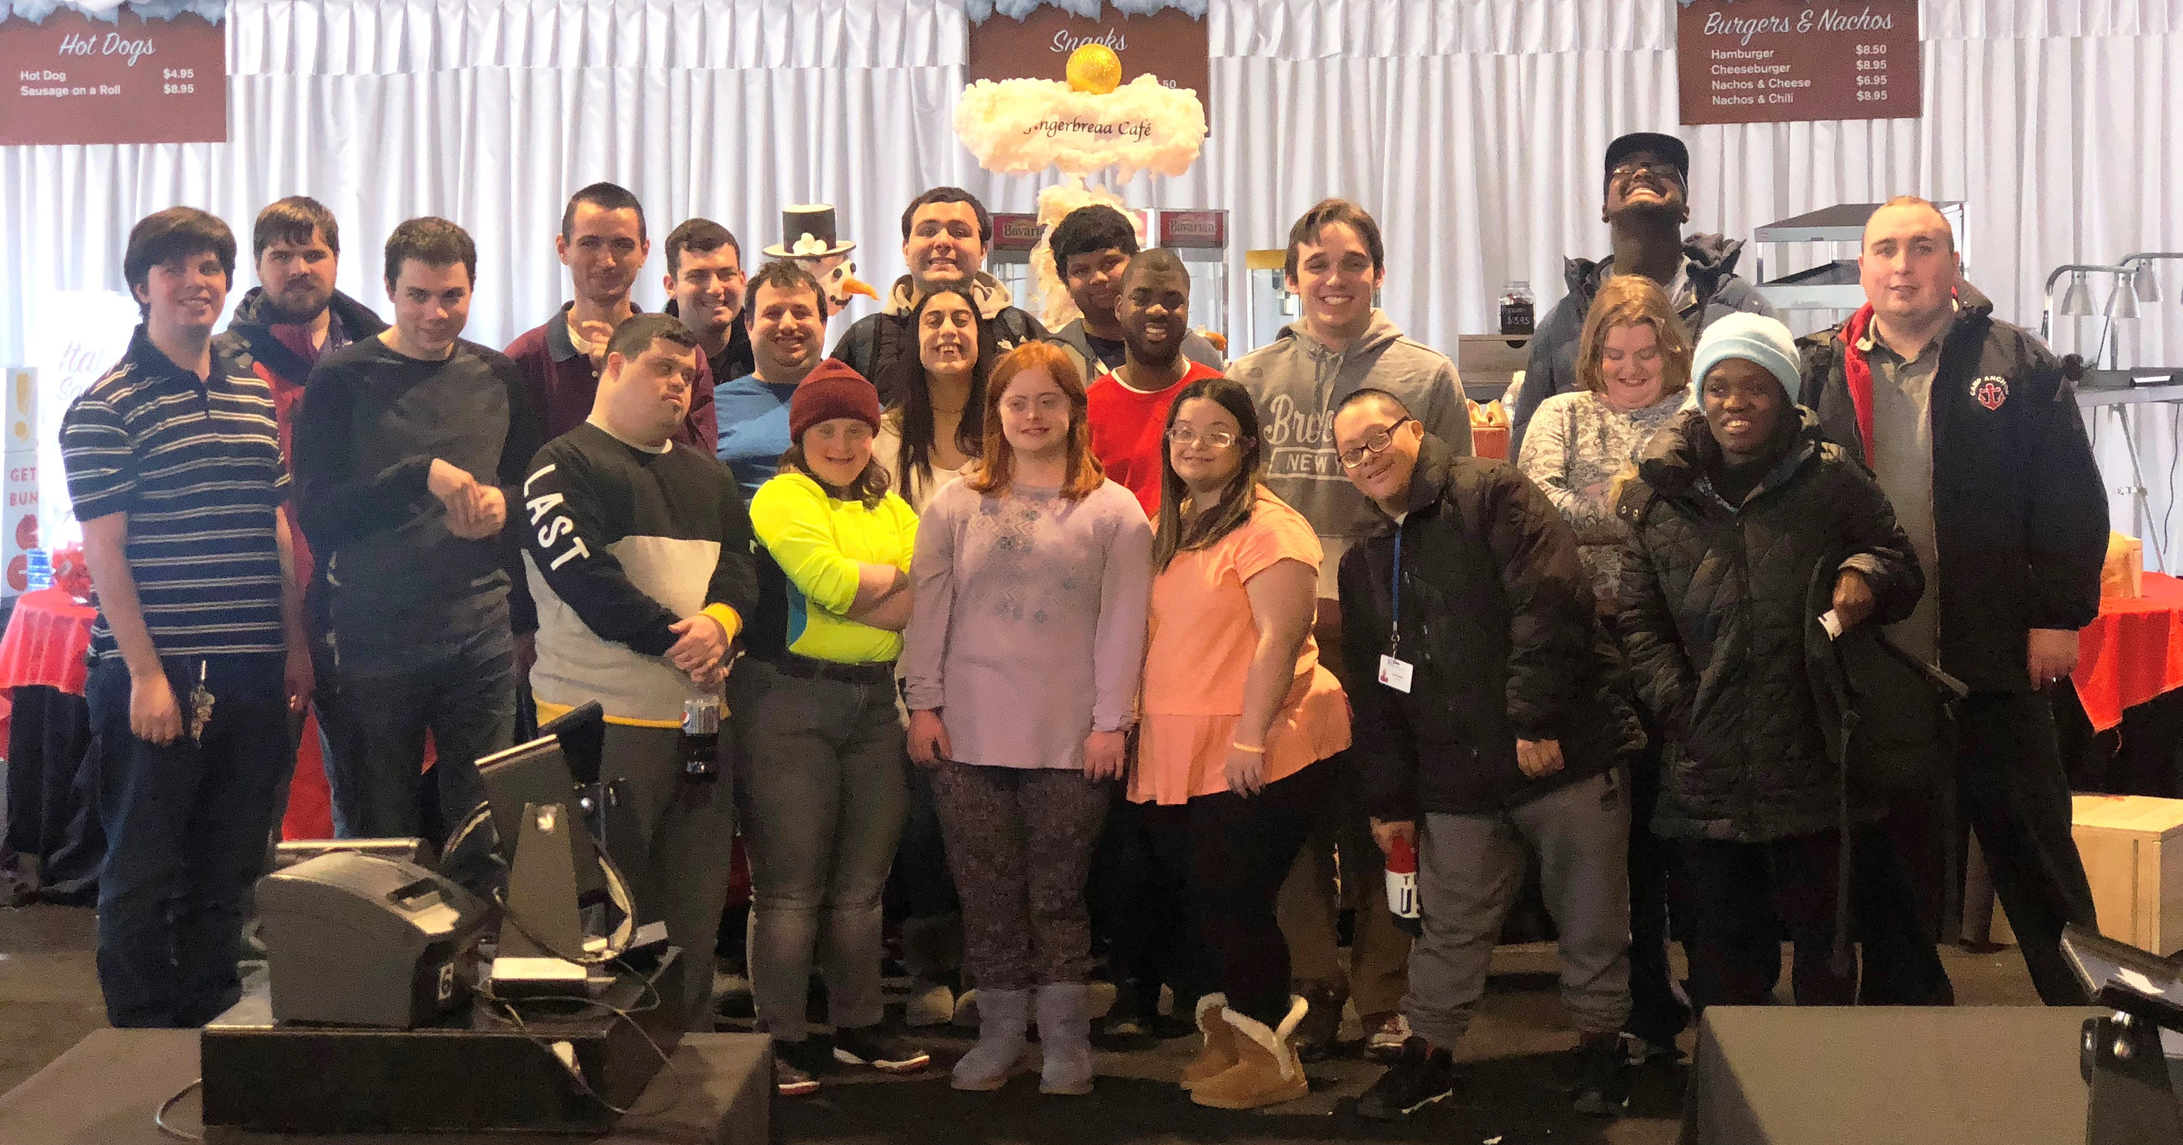
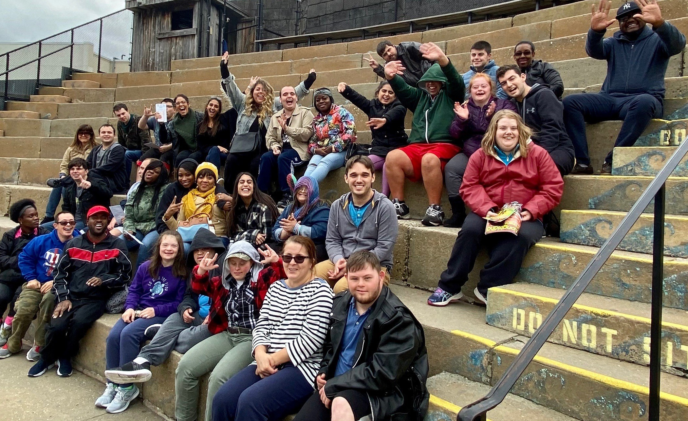
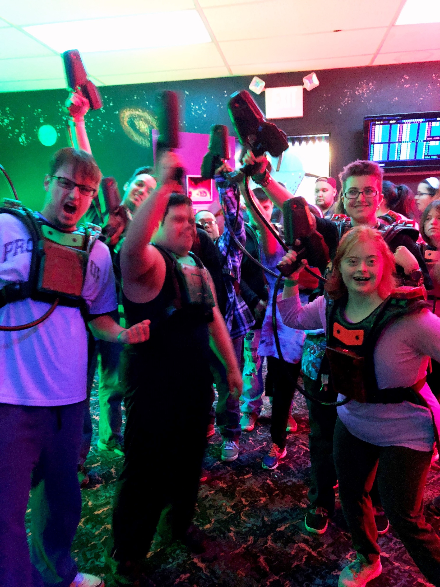
Community Trips

Slide 19
Thank you
To our incredible staff!!
A message from a couple
of our persons supported…

Slide 20
For More Information, Contact:
Lasana Rayside
Director of Day & Community Services
lrayside@humanfirst.org
Alexandra Sanchez
Coordinator of Day Services, LI
asanchez@humanfirst.org
Human First Pride Center
1 Michael Avenue
Farmingdale, NY 11735
Phone: (631) 321-1101
Fax: (516) 249-3400

